Slide 1

Procedure Demonstration
For safety information, visit www.legacymedicalconsultants.com/actigraft-safety-info
25-ACT-0007-rev1

Slide 2
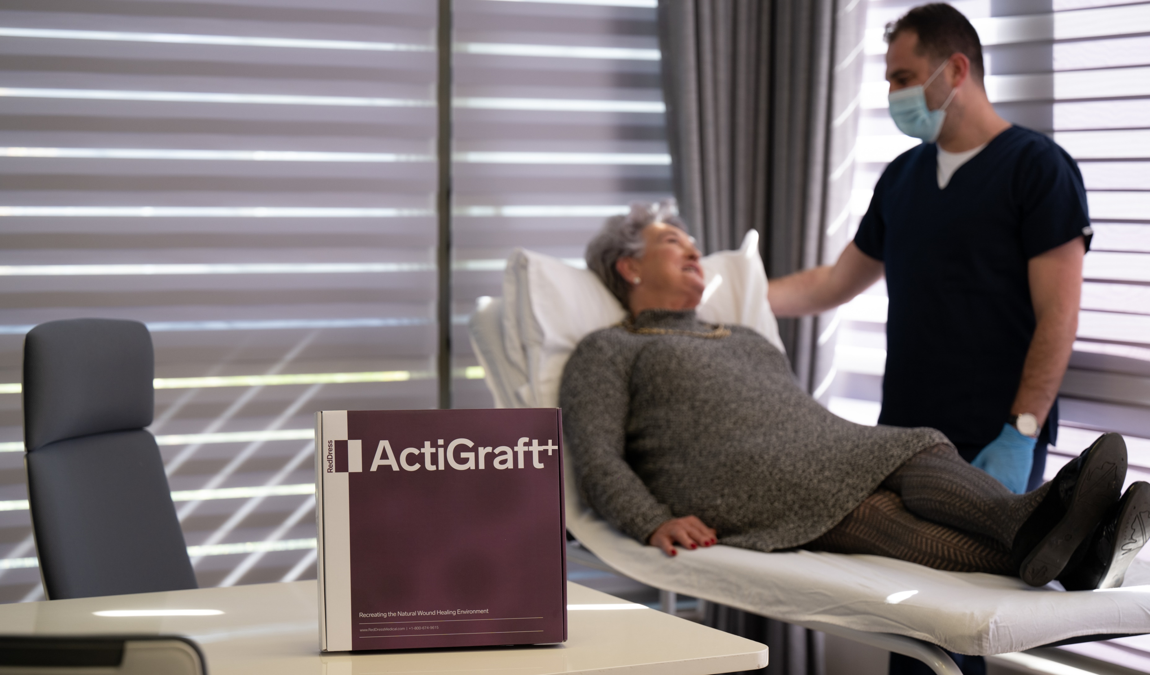
+
The ActiGraft^{+ ®} system provides single-use components needed for a safe and rapid preparation of Whole Blood Clot (WBC) from a sample of a patient’s own blood.

Slide 3
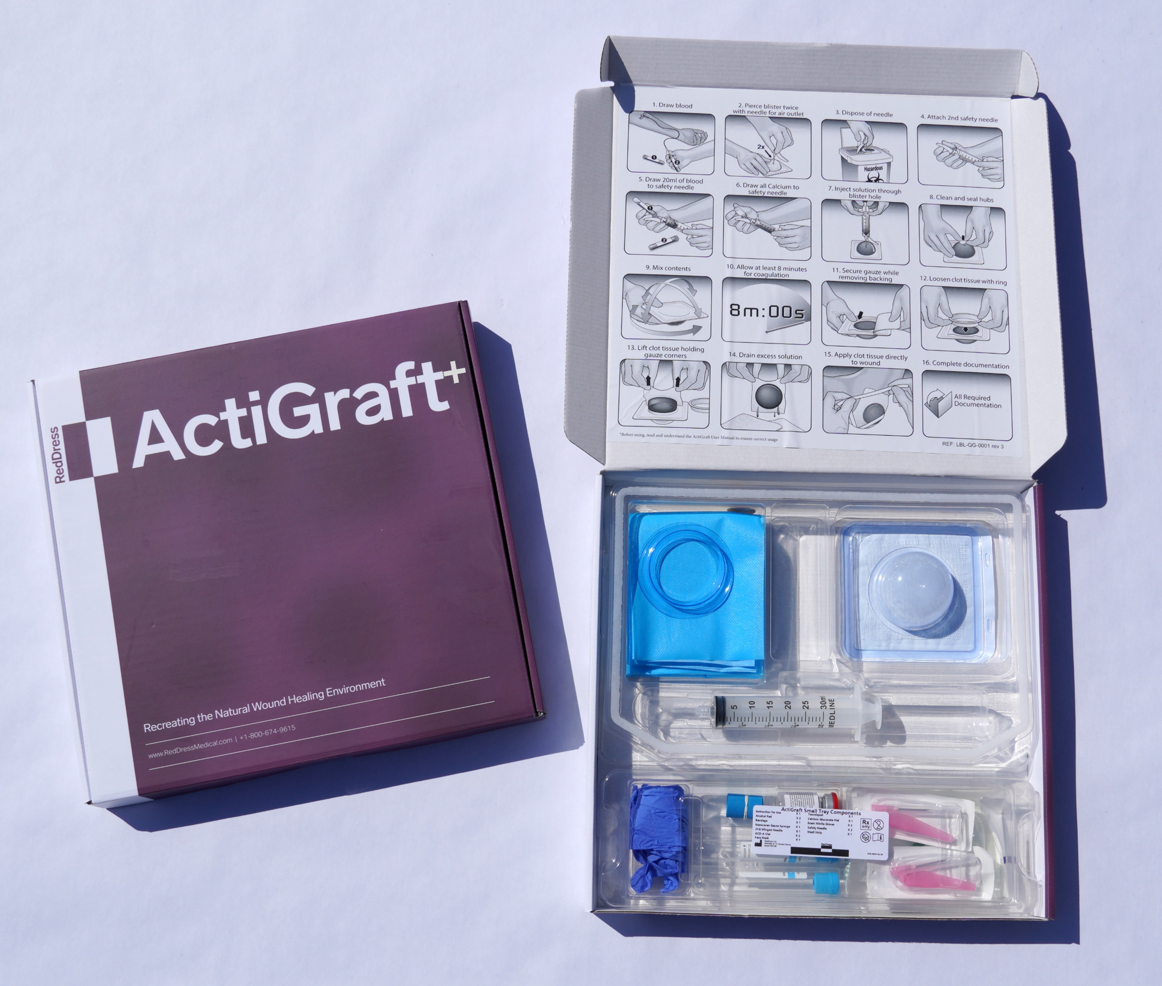
+
ActiGraft⁺ contains a Patient Phlebotomy Kit, a Coagulation & Accelerator Kit, and
additional accessories needed to produce the WBC.

Slide 4
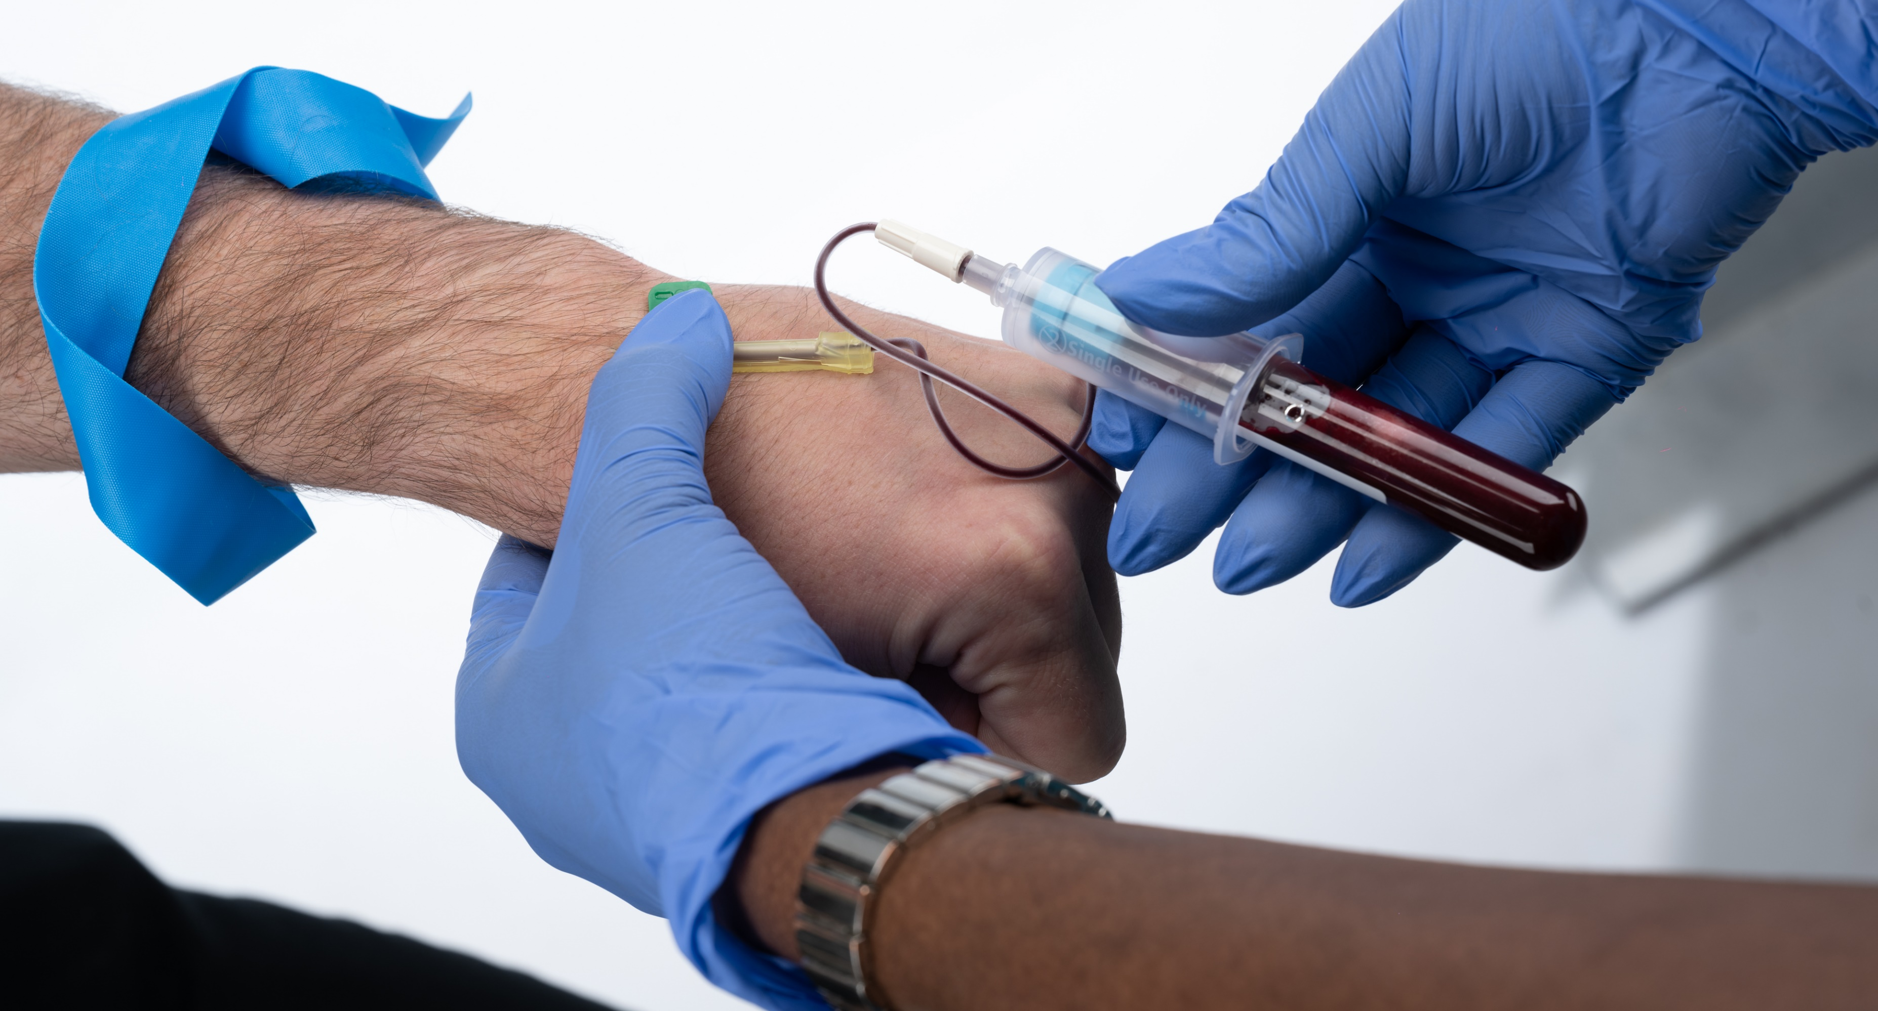
Before draw, agitate tube to coat glass with ACDA
Completely fill the two 10ml tubes with the patient’s blood to ensure proper coagulation.
Gently mix the tubes and place in the kit until needed.

Slide 5
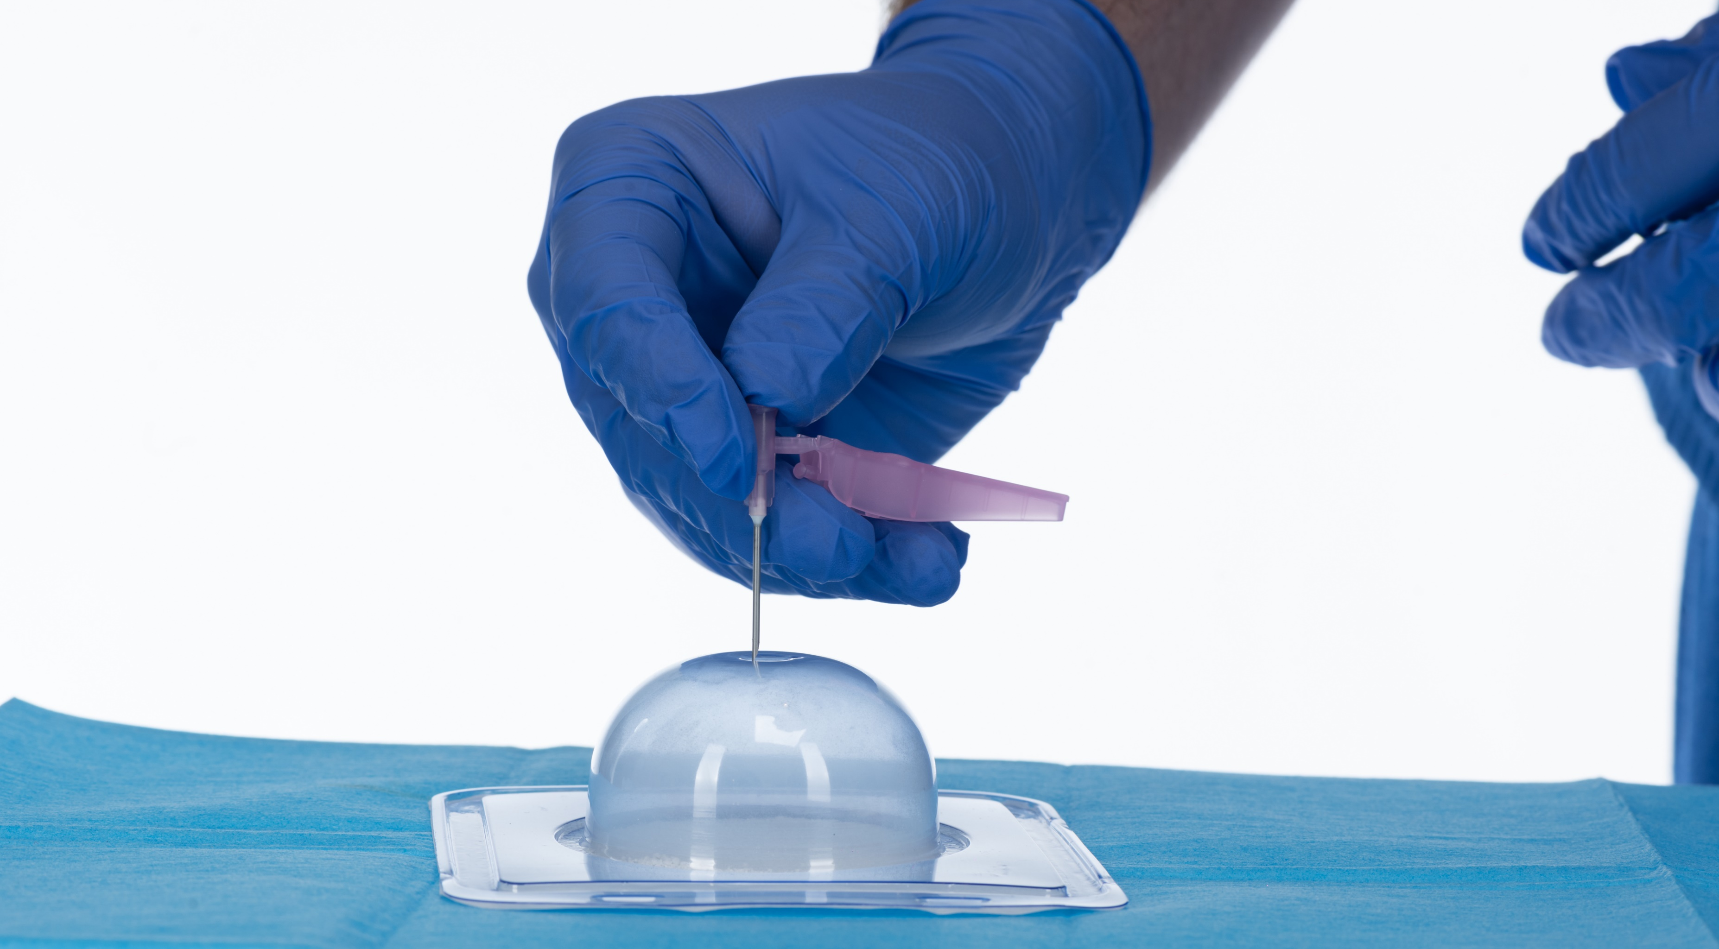
Puncture the coagulation mold twice in the concaved hub at the top center of the mold. The first puncture will serve for blood injection, the second puncture as an outlet for air.
Dispose of needle.

Slide 6
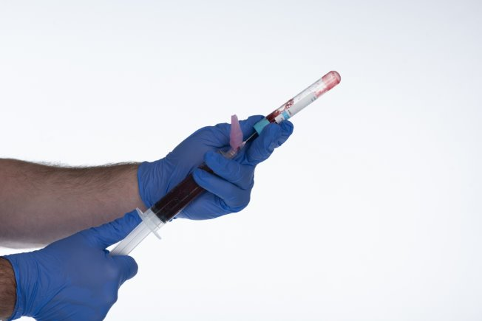
Agitate tube to mix before transferring blood.
Attach the second safety needle to the syringe.
Hold the blood tubes and the syringe at angle.
Draw the tubes of blood into the syringe.
Absolutely NO air in syringe – air can disrupt clot formation.
Do NOT “bump” air into the ACDA tube – this can cause tube caps
to pop and reduce effectiveness.

Slide 7
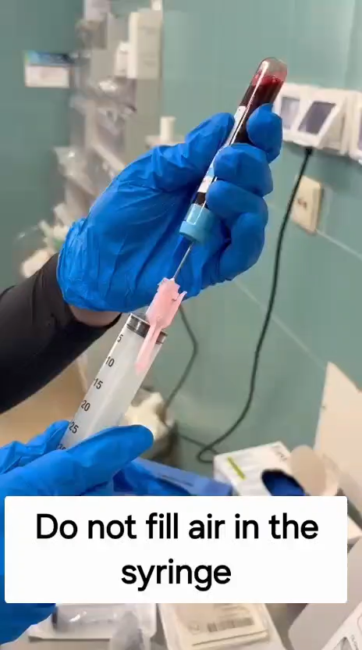

Slide 8
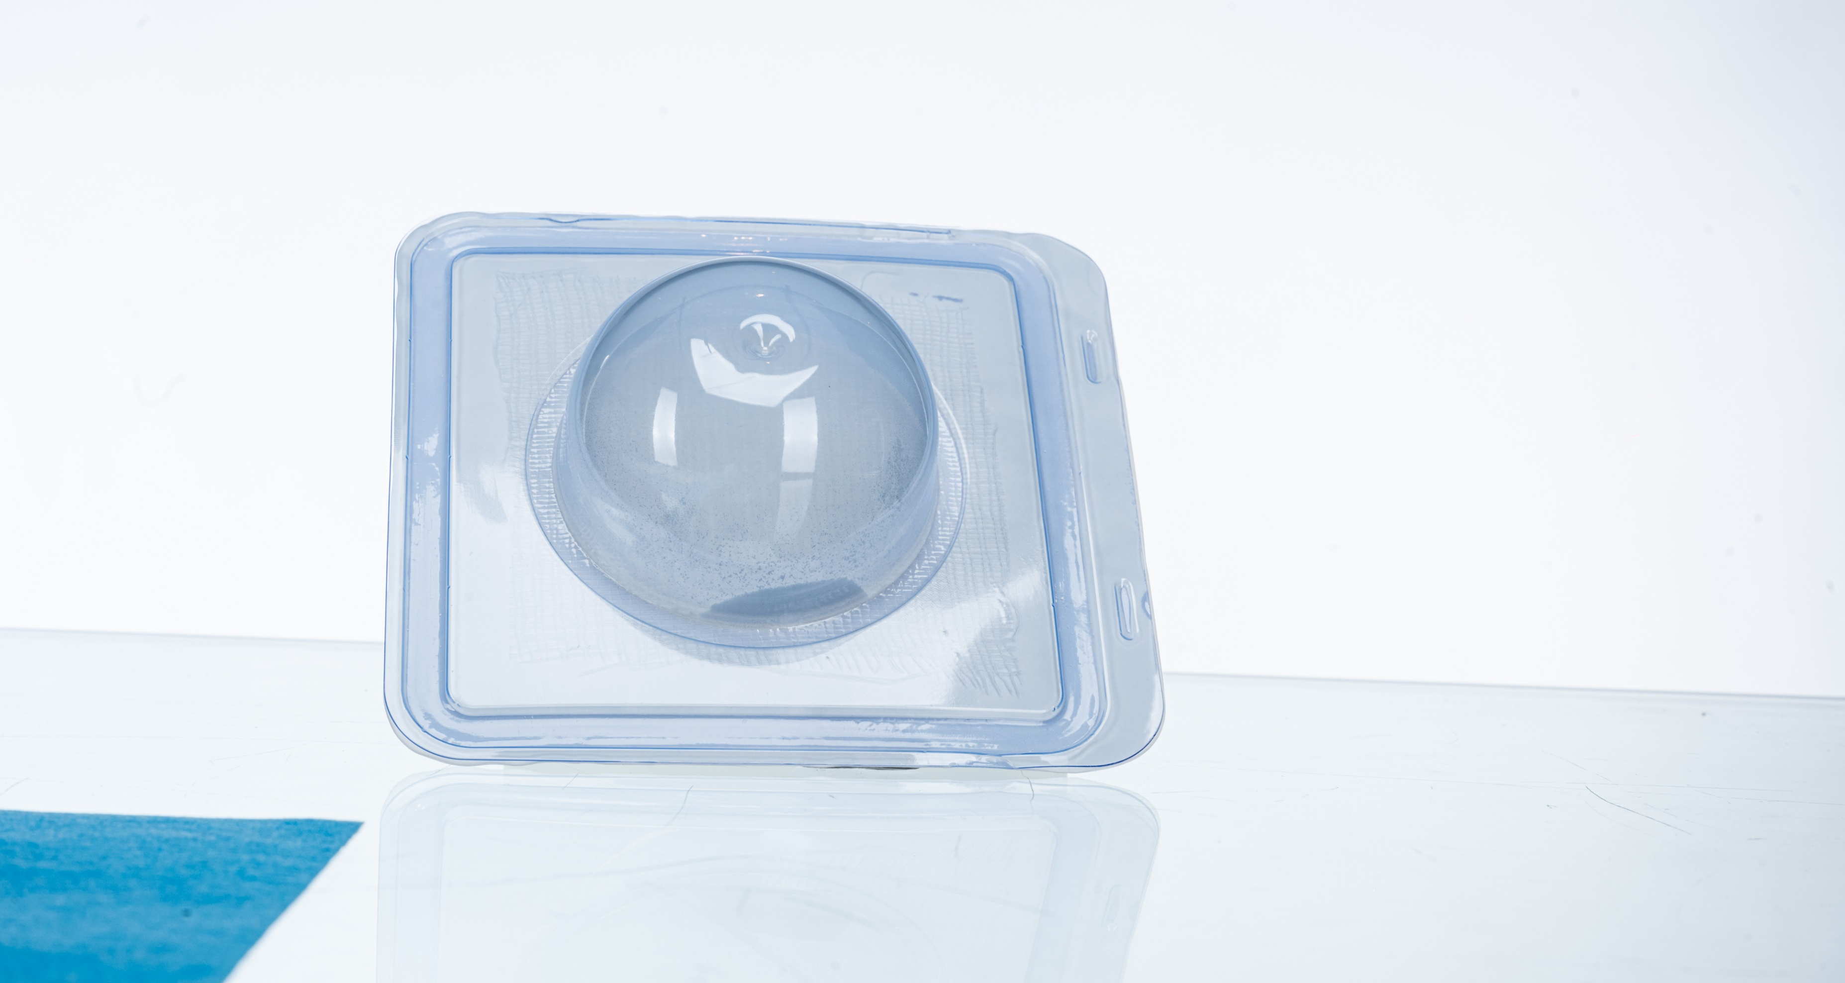
The coagulation mold contains a patented coagulant formula consisting of kaolin powder and calcium gluconate powder.

Slide 9
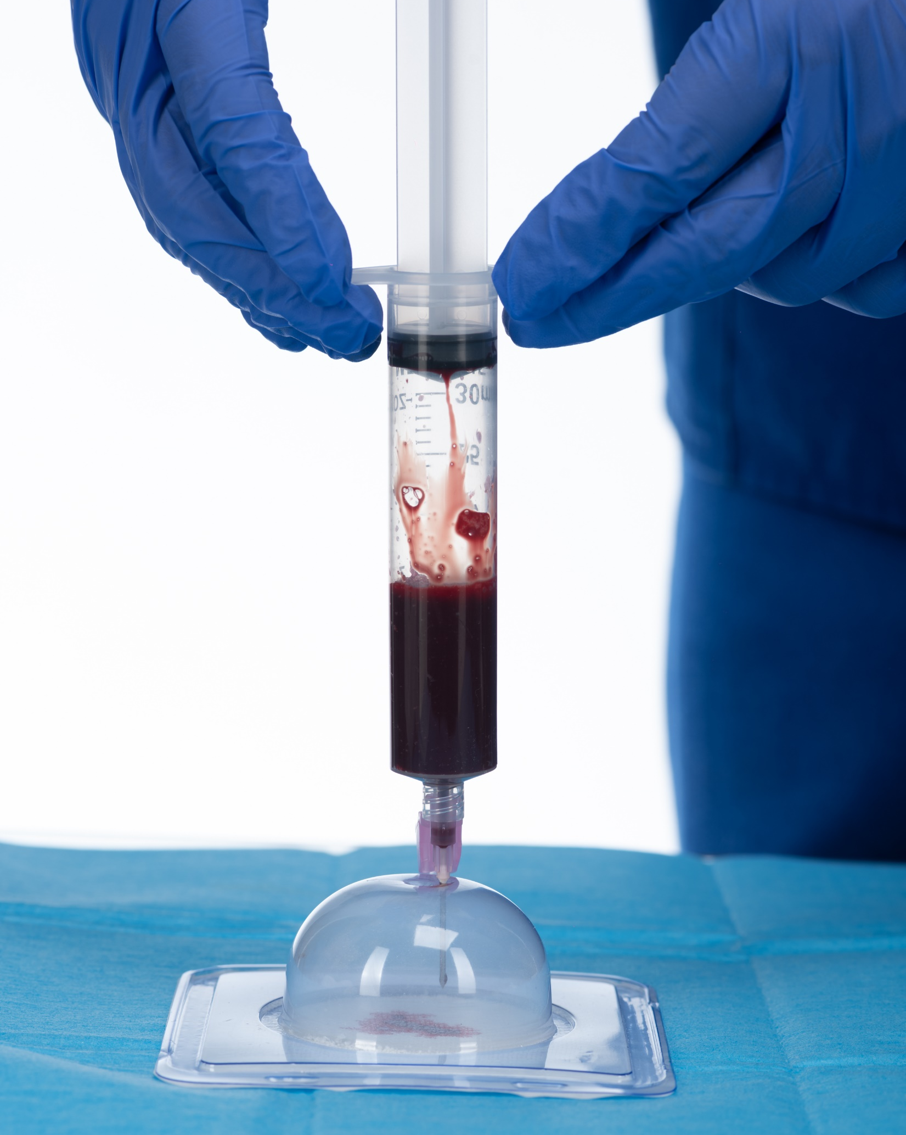
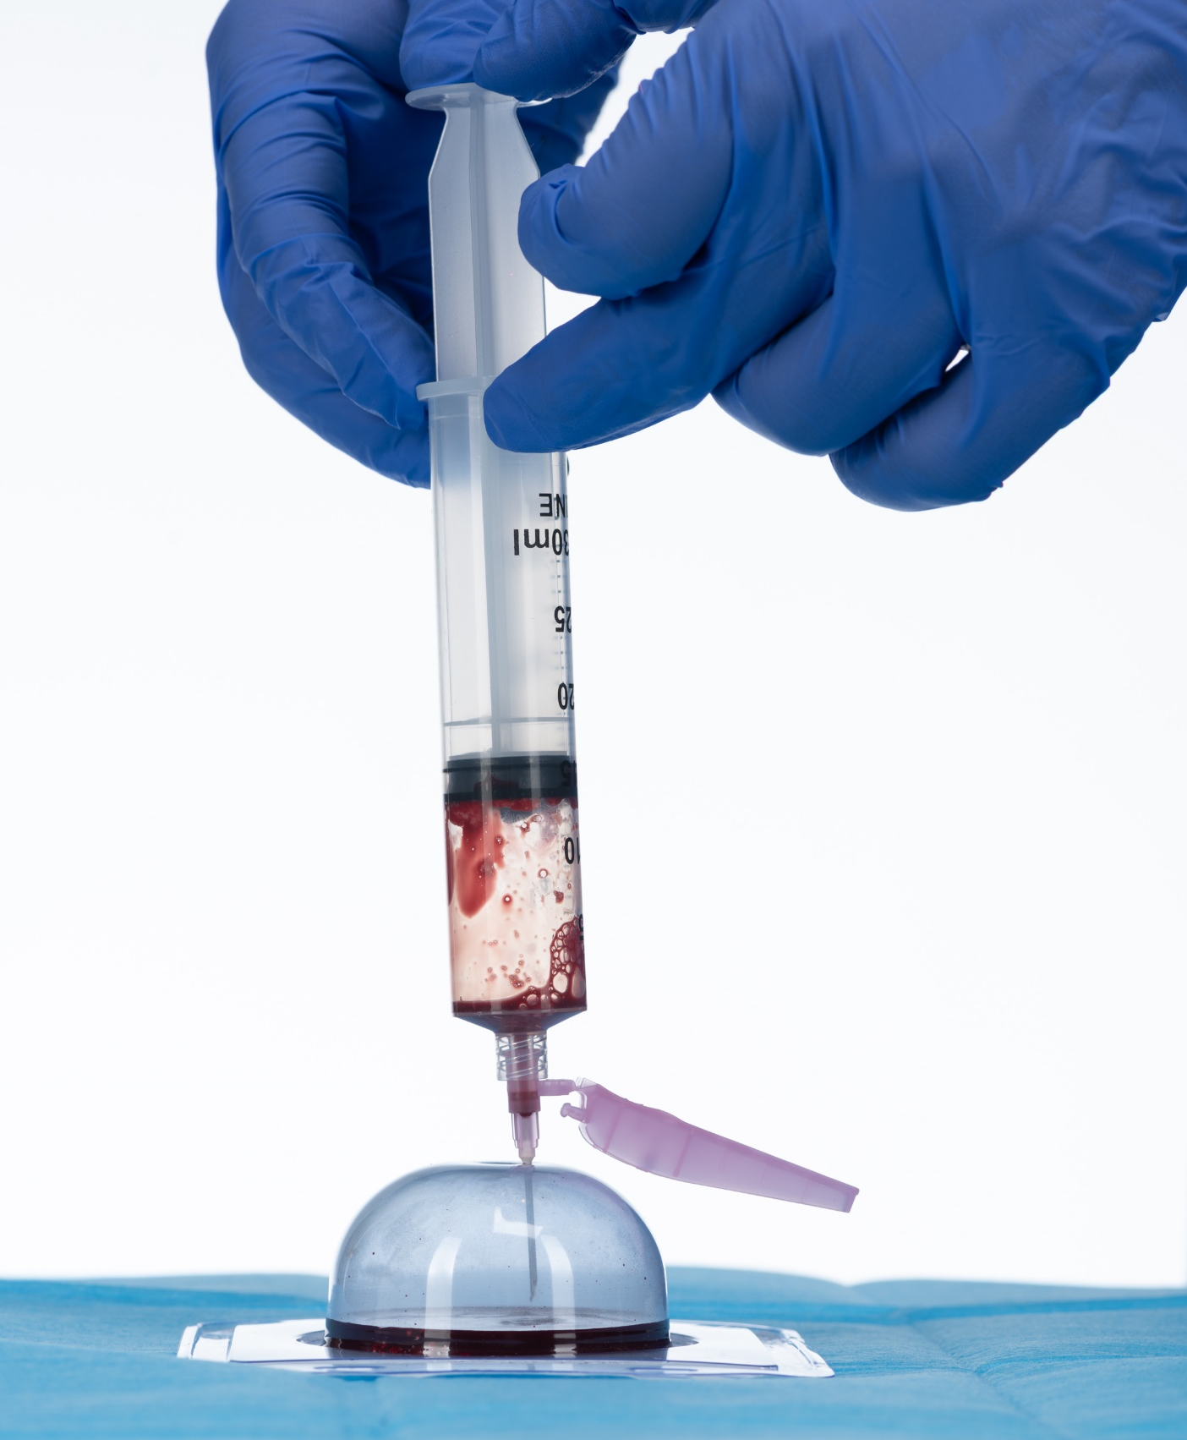
Insert the syringe into one of the two puncture holes in the coagulation mold. Slowly
inject the contents of the syringe into the coagulation mold.

Slide 10
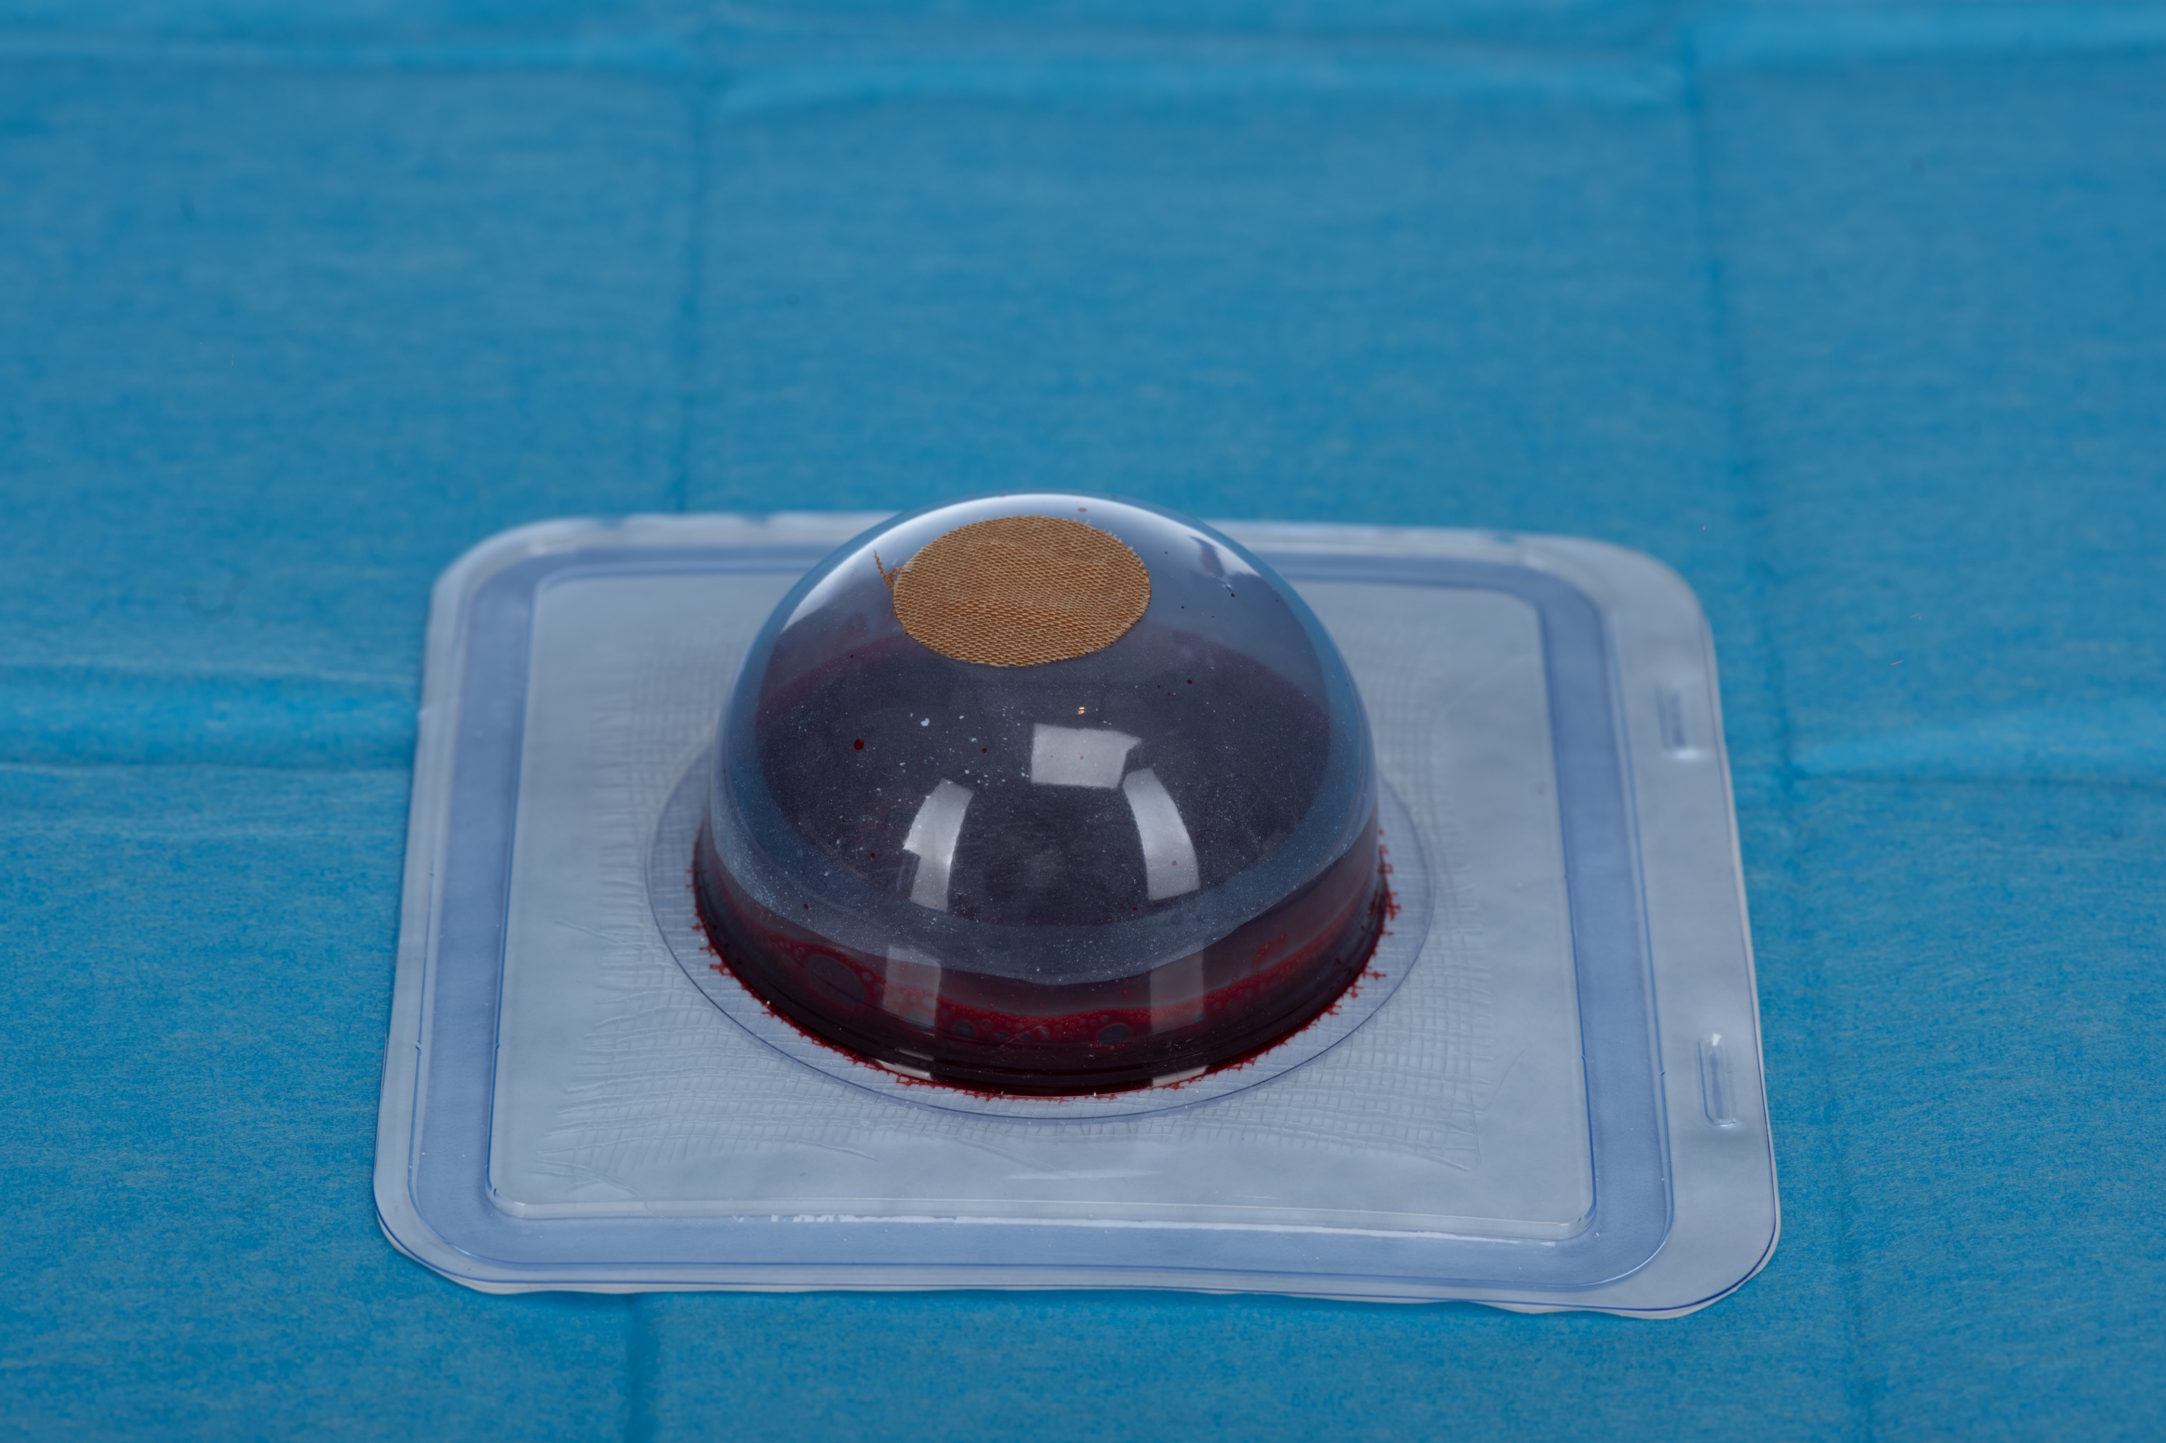
Clean and seal the hub of the coagulation mold with provided round bandage contained in kit.
Ensure you rub your finger around the band-aid to create a seal.

Slide 11
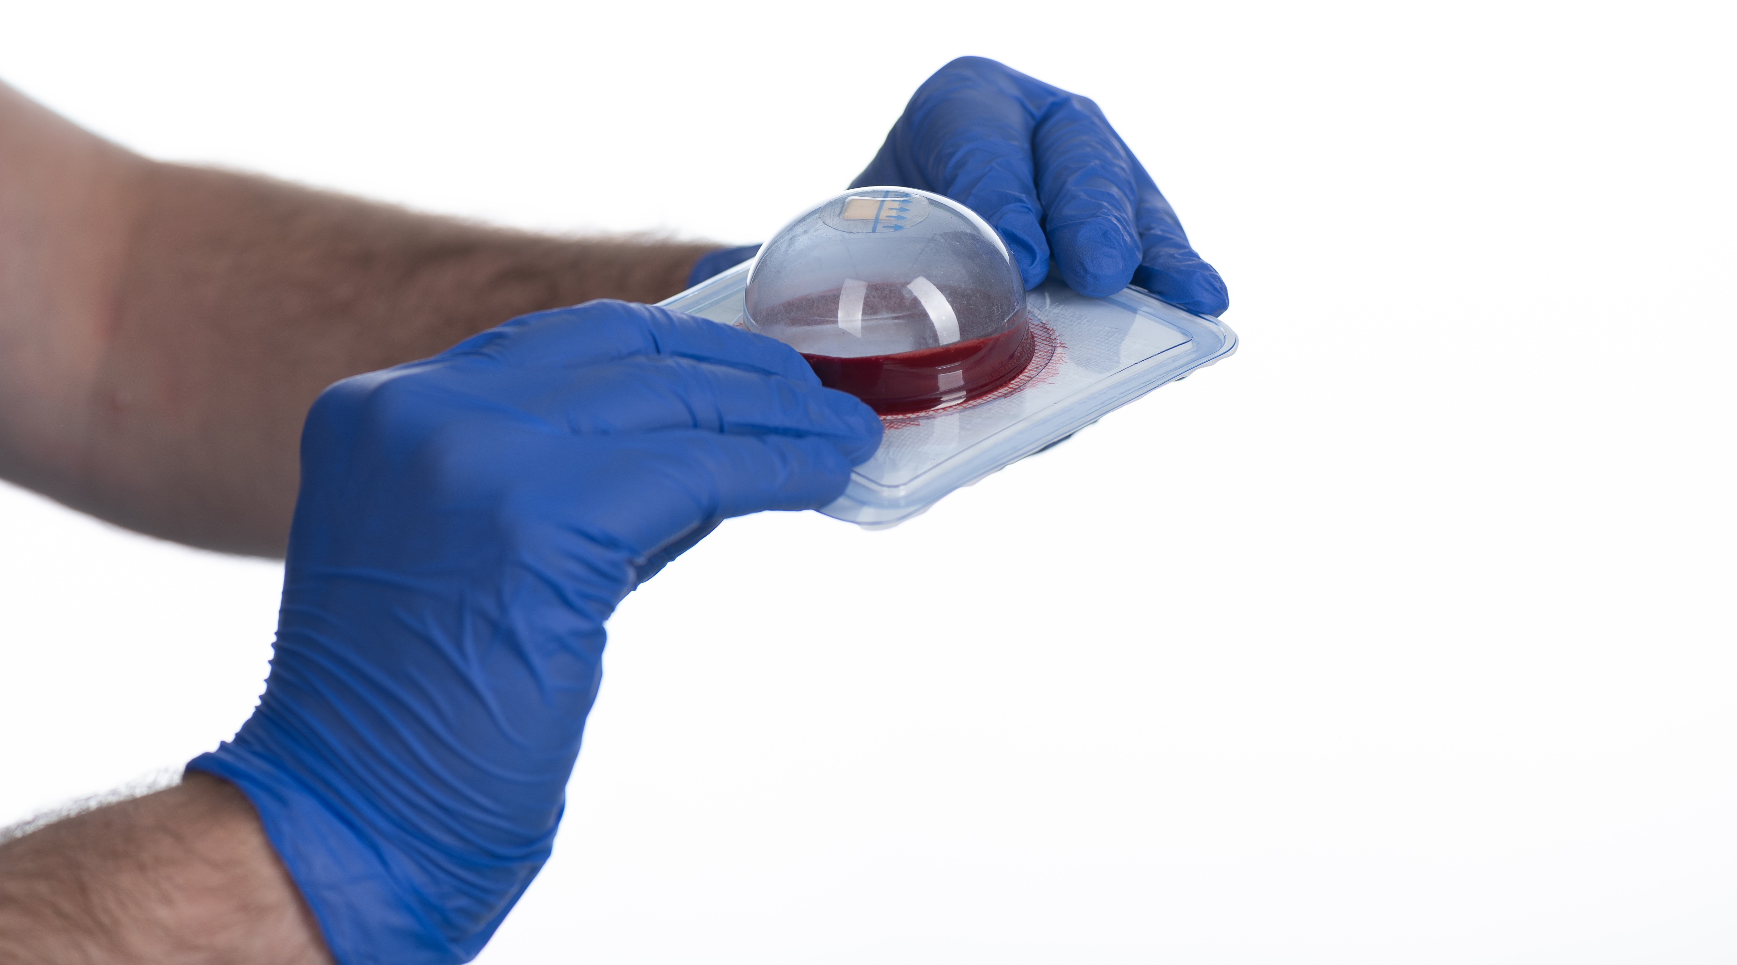
Mix the contents of the coagulation mold vigorously for at least 20 seconds.

Slide 12
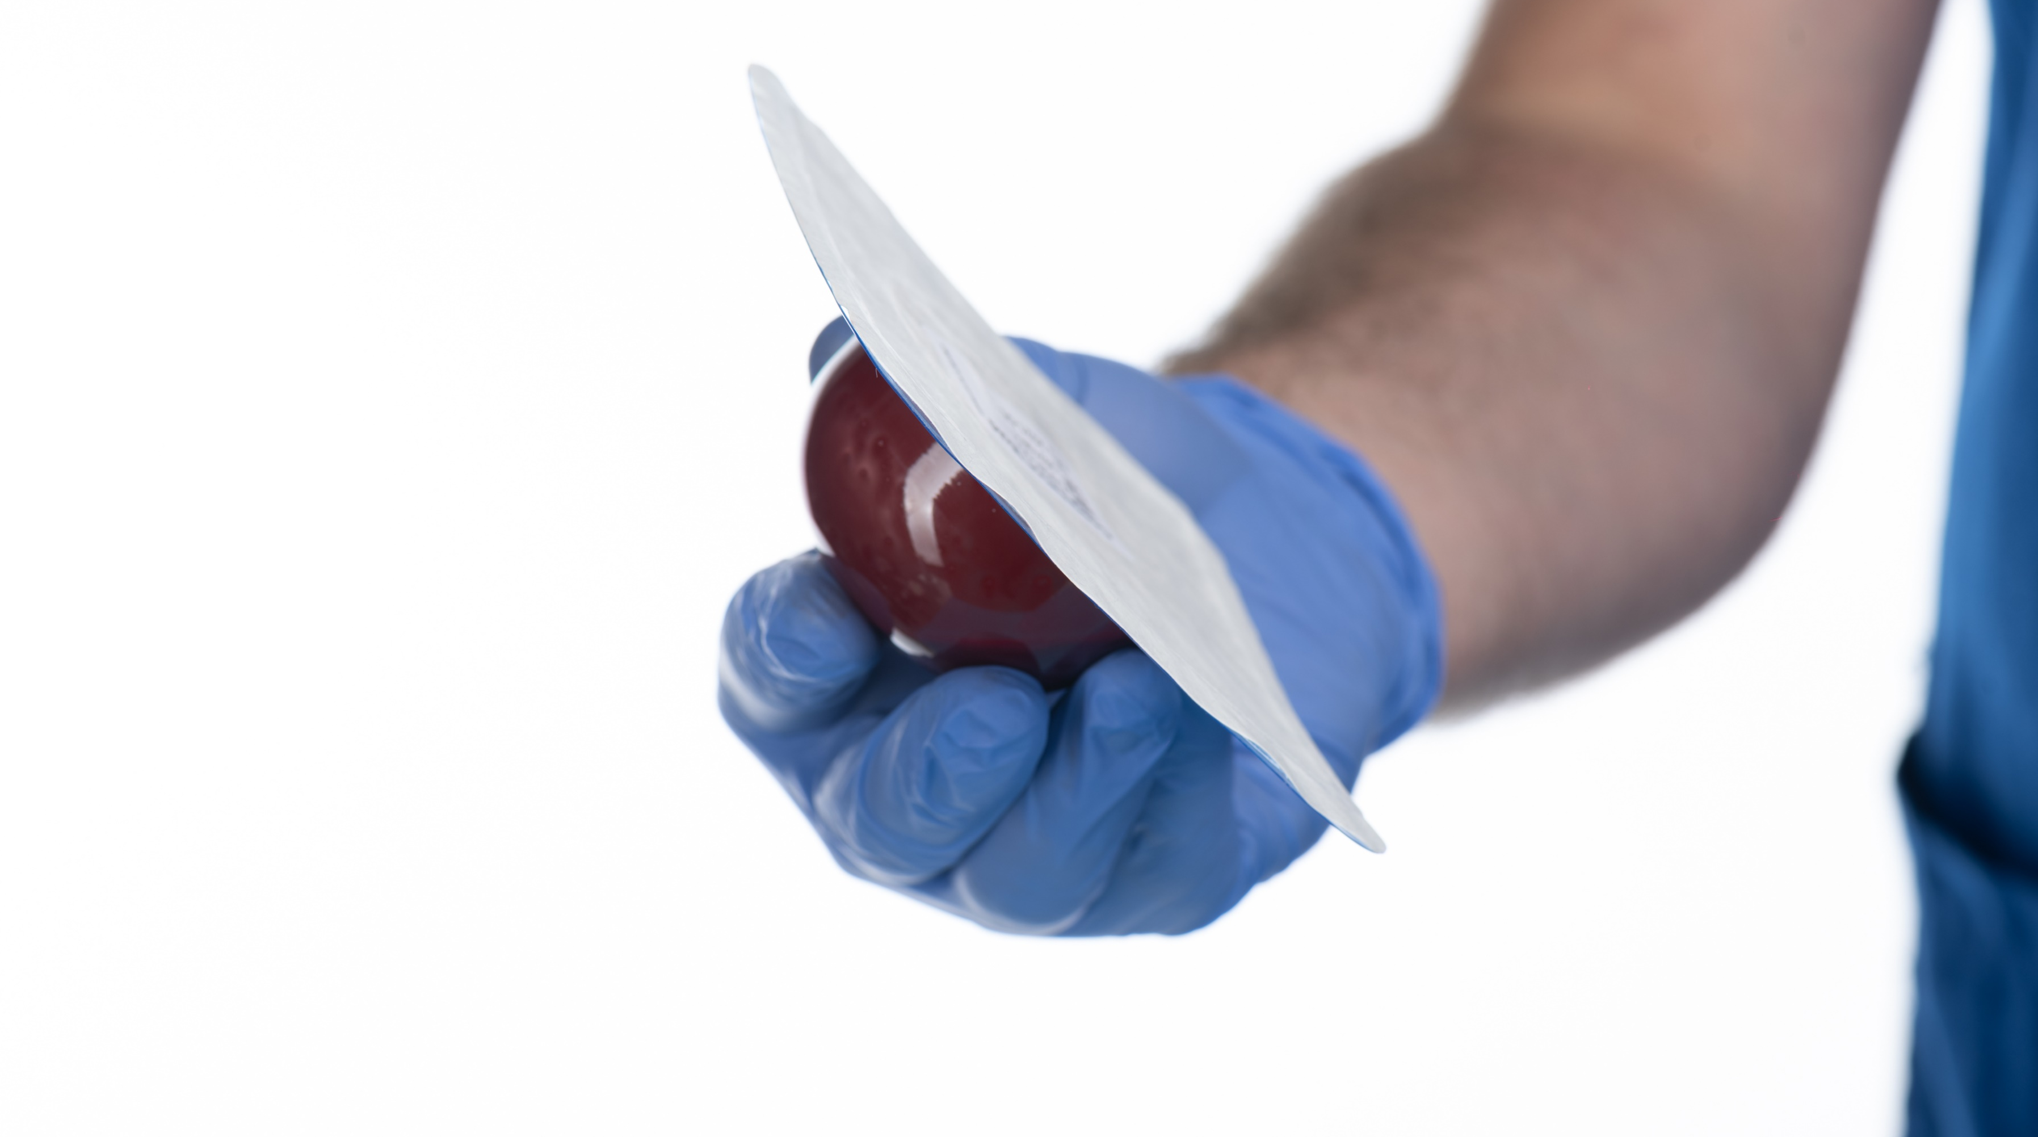
Mix the contents of the coagulation mold vigorously for at least 20 seconds.

Slide 13
Leave the coagulation mold on a flat surface with the dome facing upward.
Allow at least 5 minutes for coagulation to occur.

Slide 14
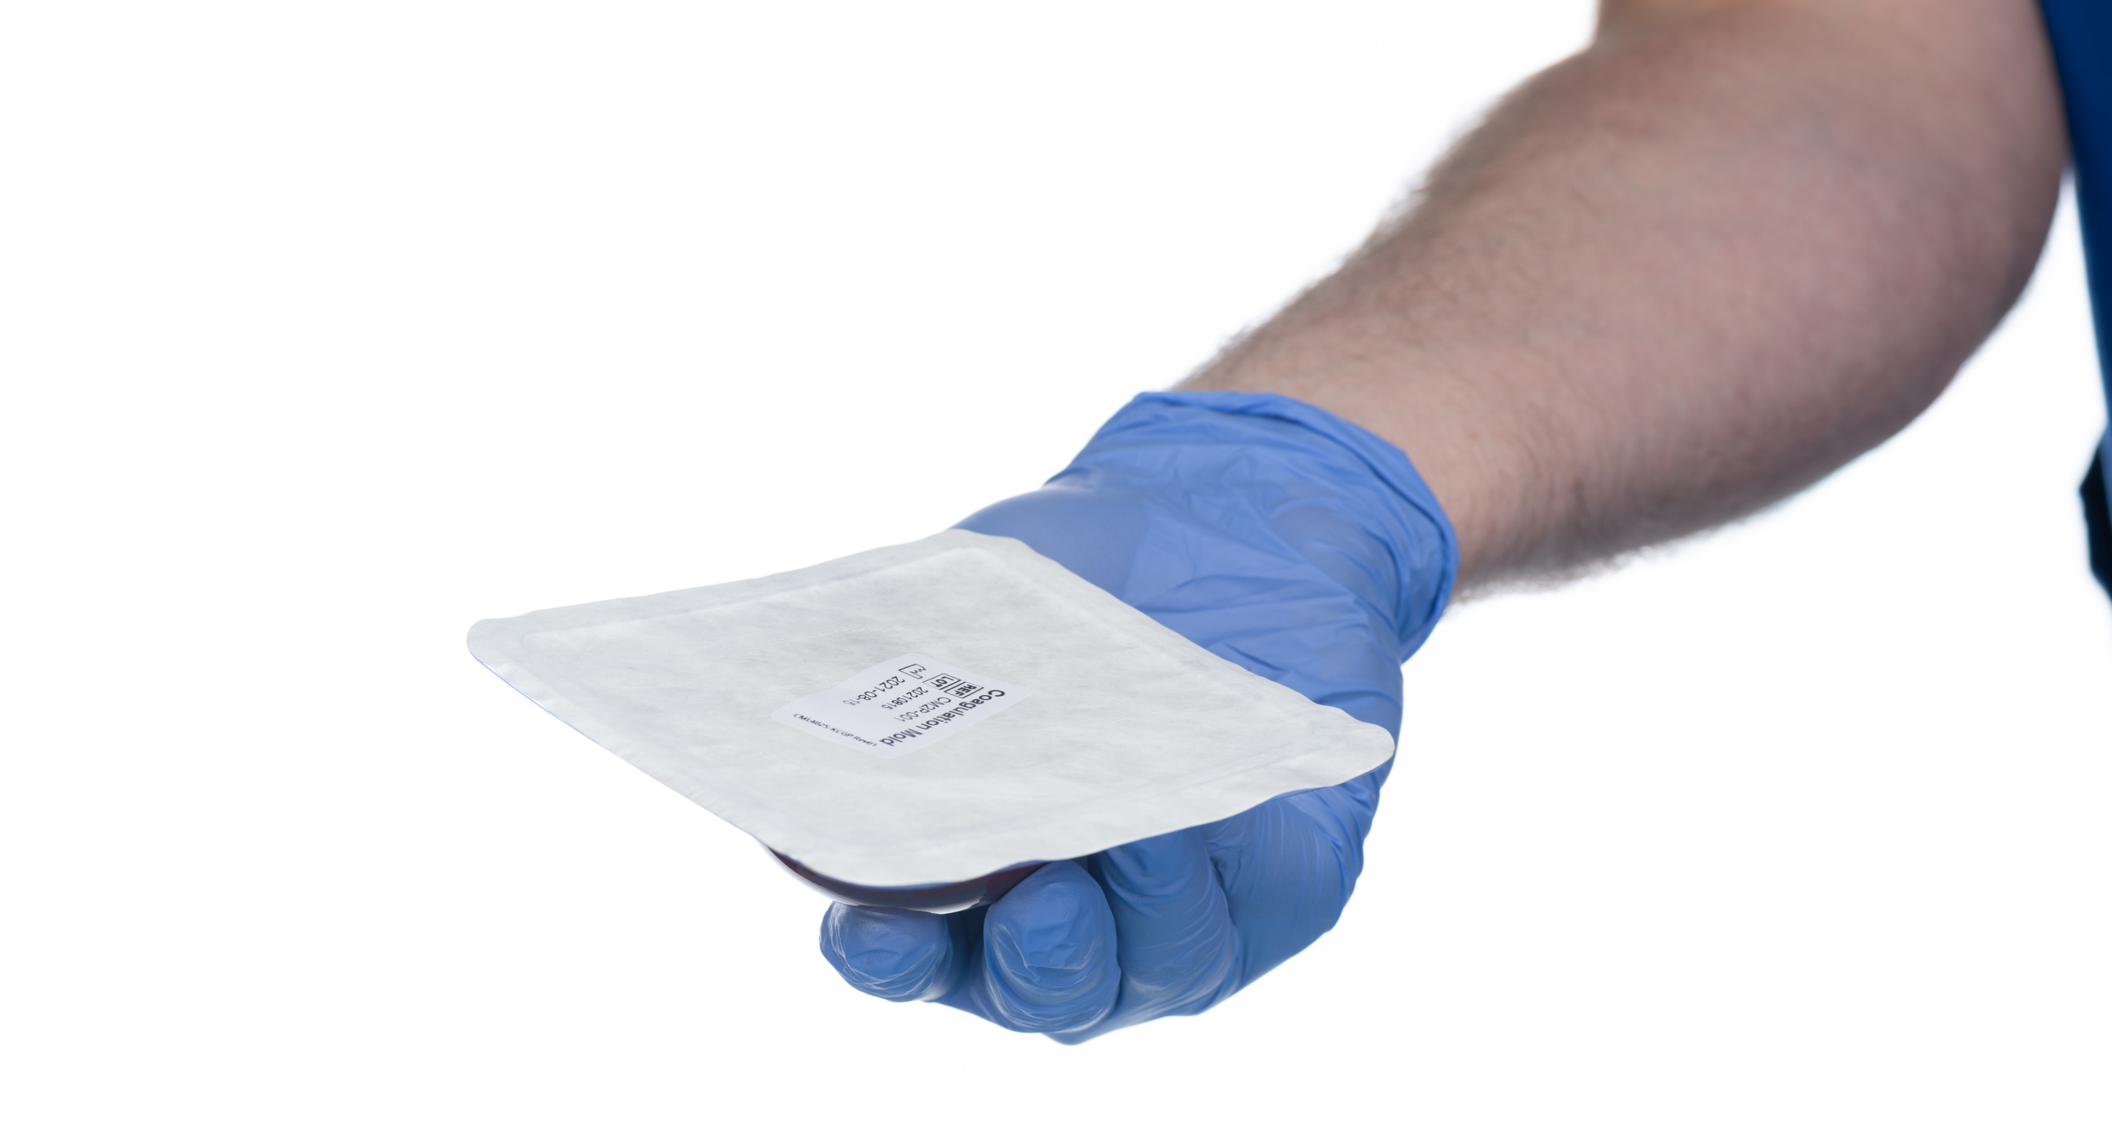
Tip the coagulation mold upside-down to begin the removal process of the WBC.

Slide 15
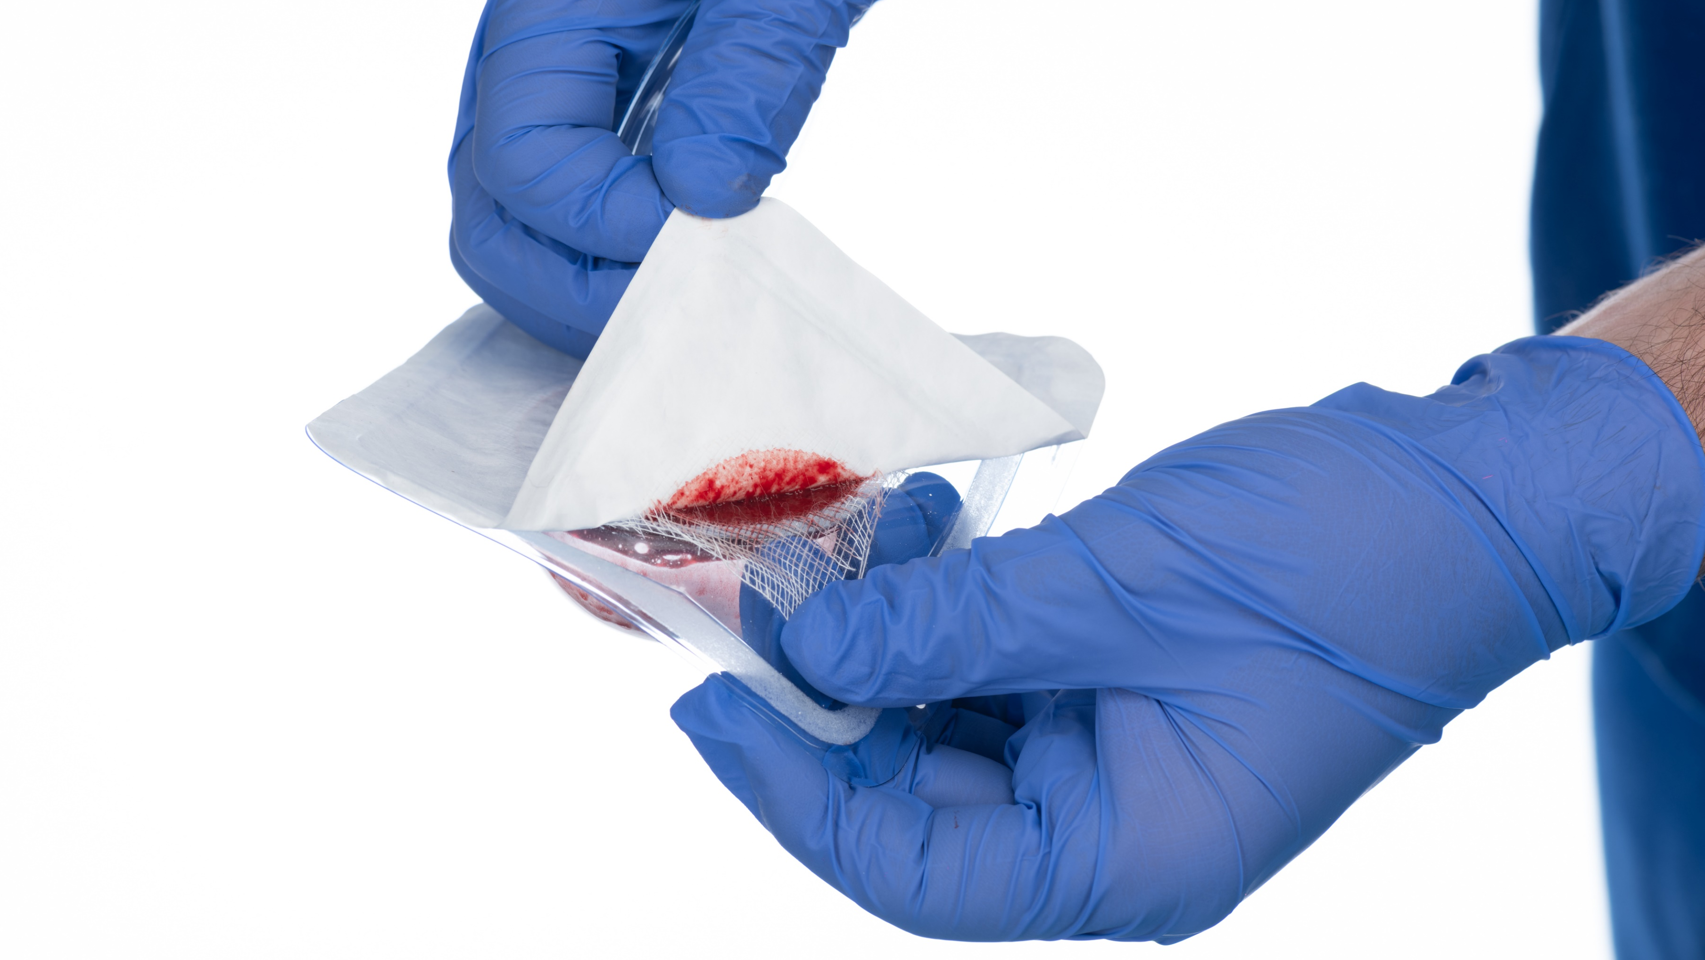
Gently peel back the Tyvek® backing while securing the gauze to the exterior edges of the coagulation mold.
Placing thumb or fingers on gauze to create opposing pressure when peeling Tyvek.

Slide 16
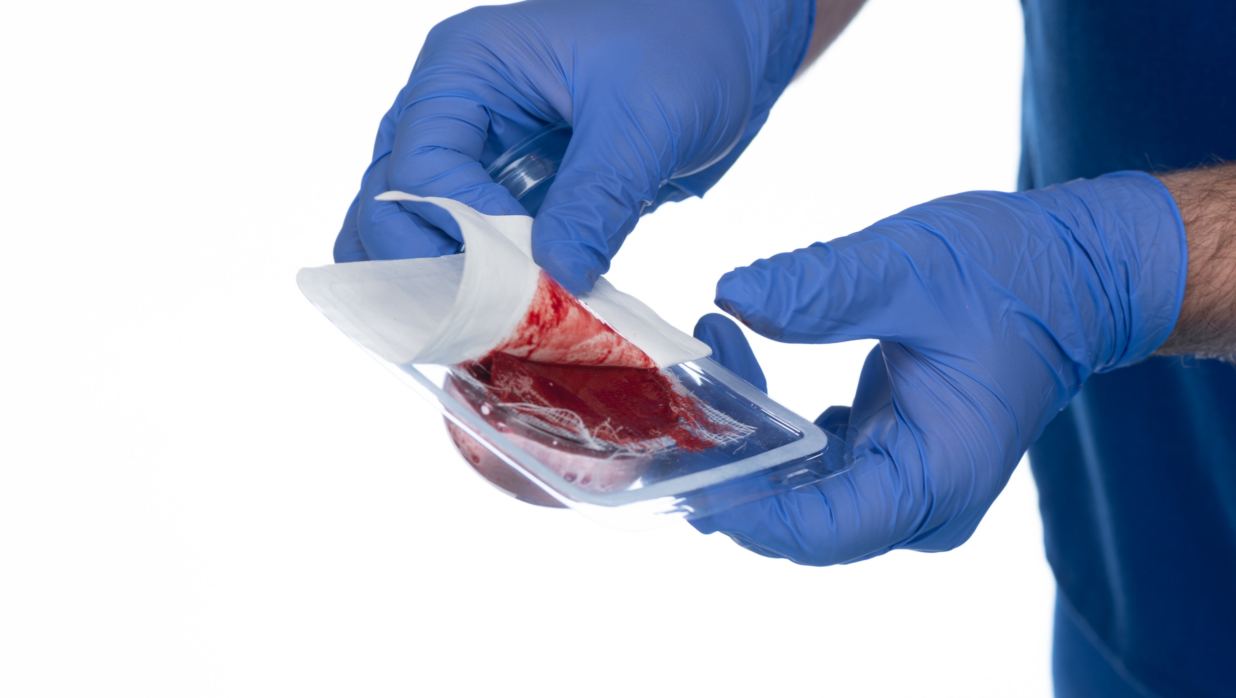
Gently peel back the Tyvek® backing while securing the gauze to the exterior edges of the coagulation mold.

Slide 17
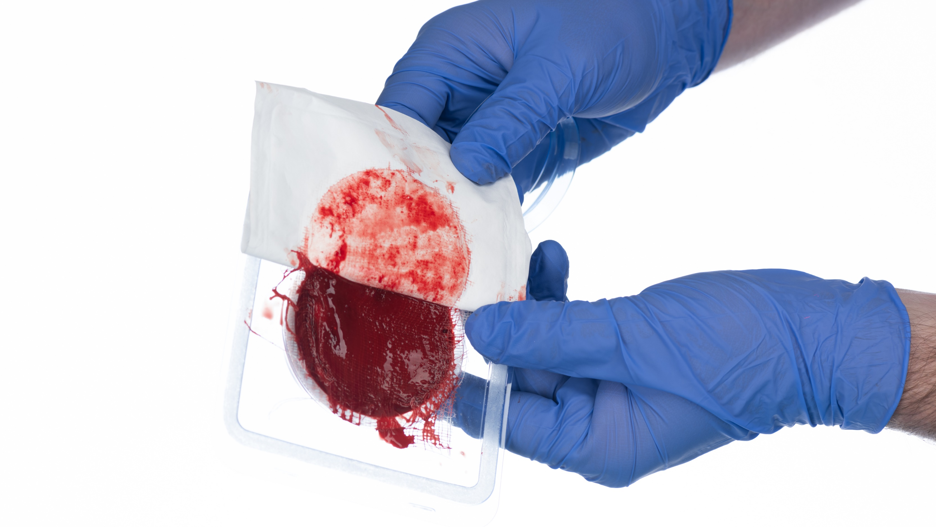
Gently peel back the Tyvek® backing while securing the gauze to the exterior edges of the coagulation mold.

Slide 18
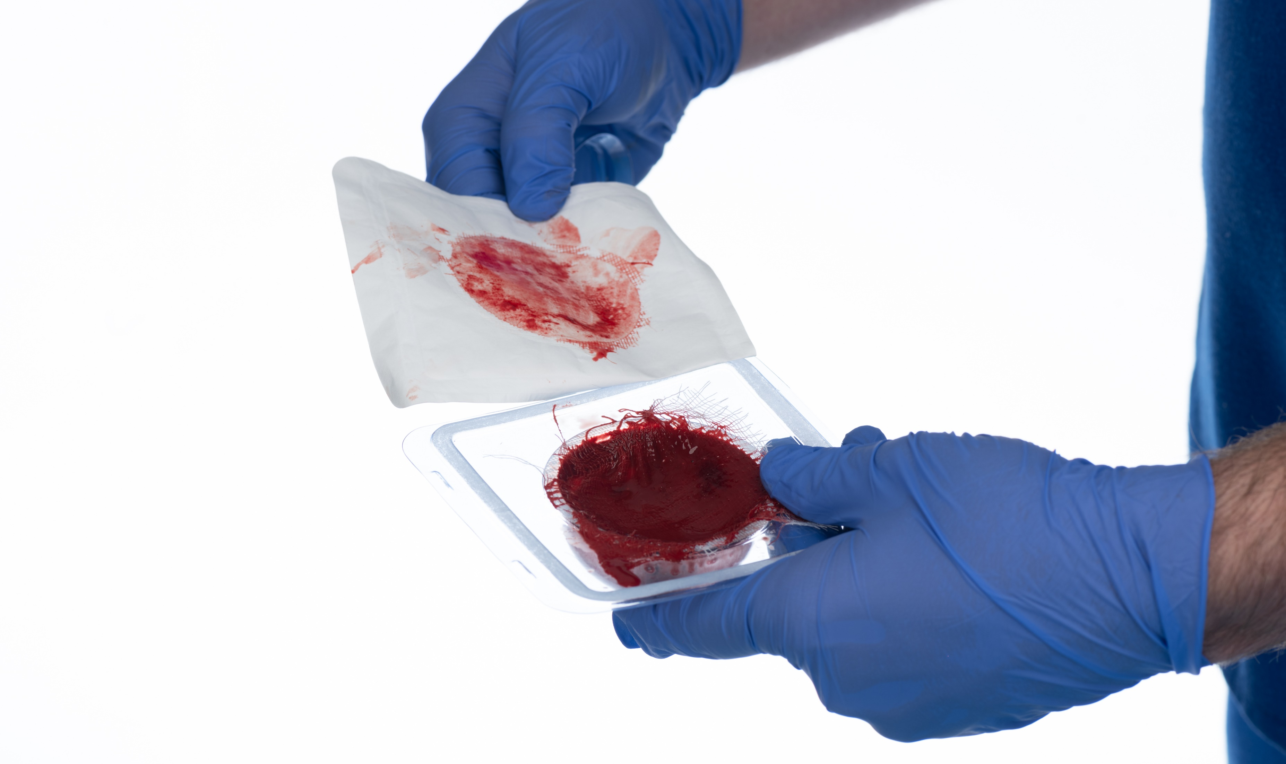
Gently peel back the Tyvek® backing while securing the gauze to the exterior edges of the coagulation mold.

Slide 19
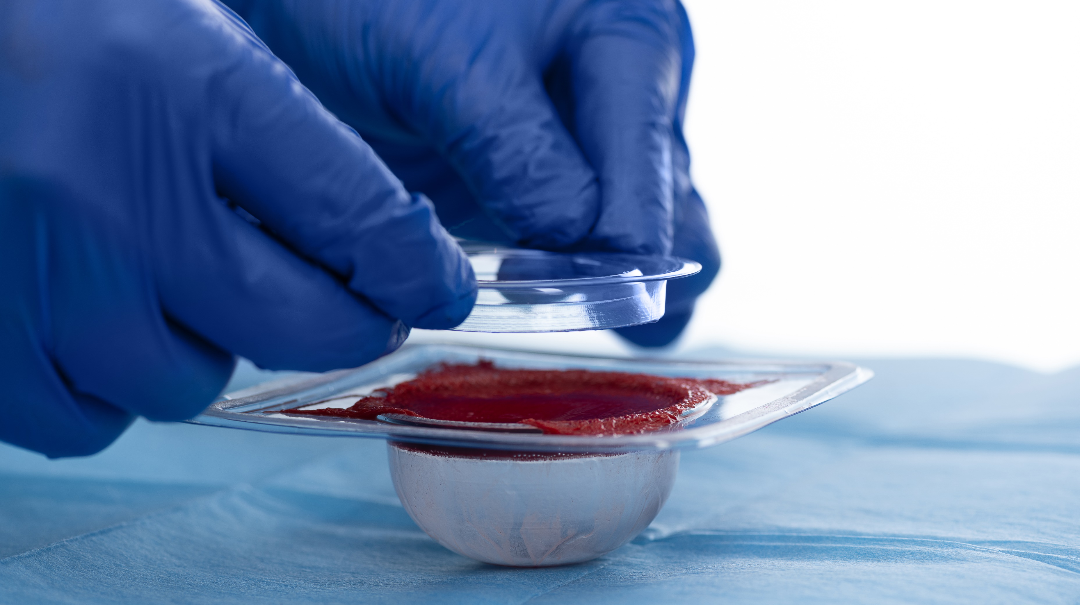
Loosen the WBC from the edges of the coagulation mold using the plastic ring provided in the Coagulation & Accelerator Kit.

Slide 20
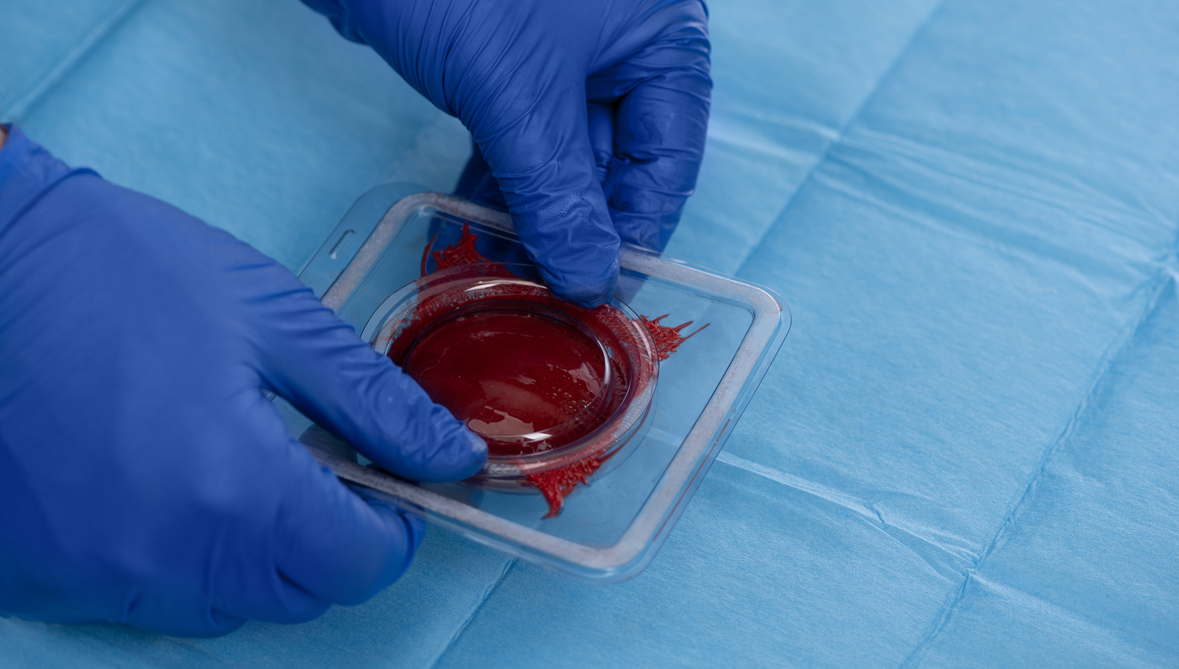
Loosen the WBC from the edges of the coagulation mold using the plastic ring provided in the Coagulation & Accelerator Kit.

Slide 21
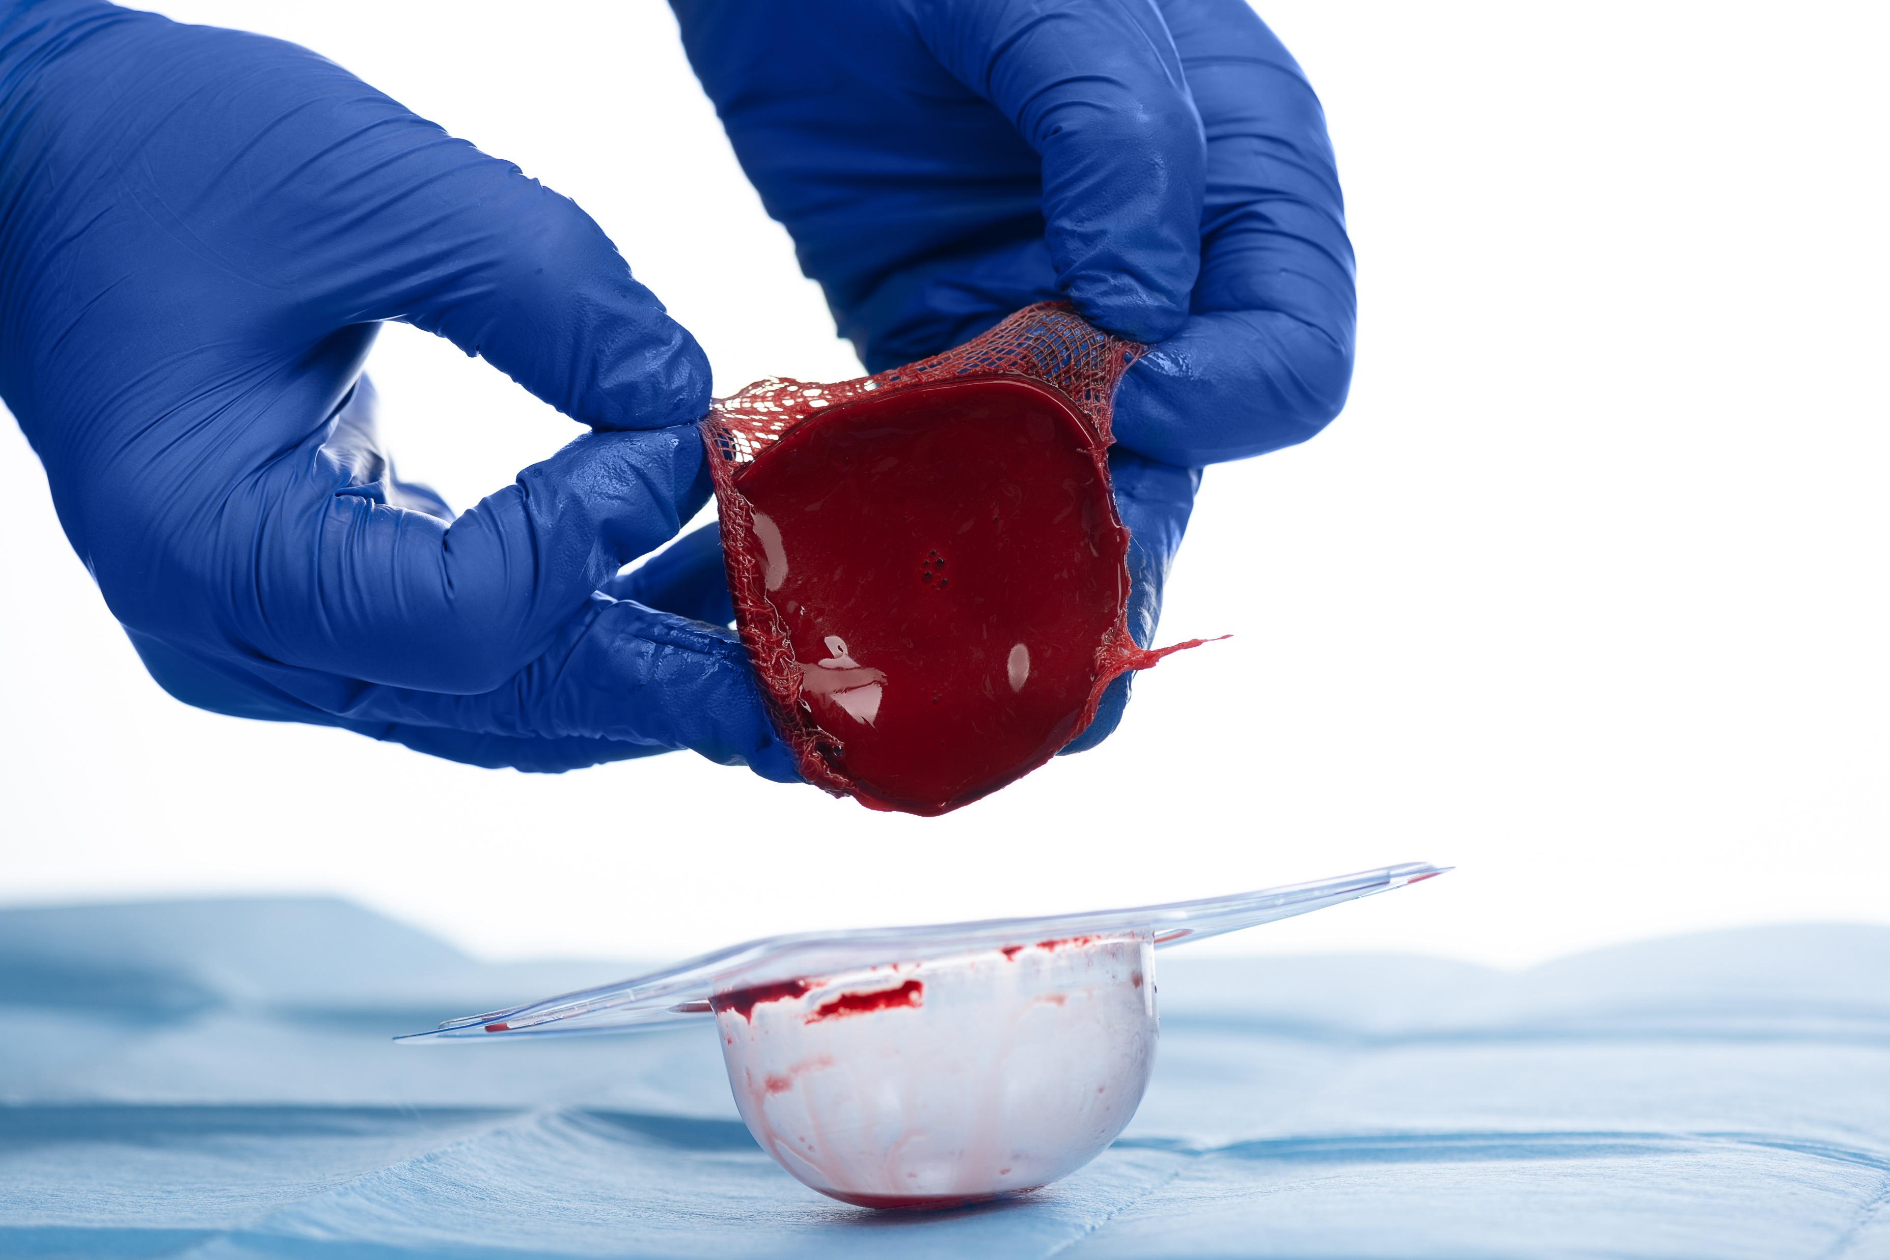
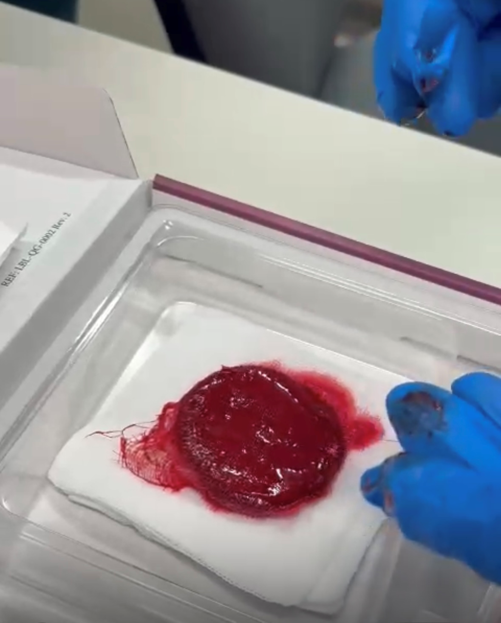
Lift the WBC out of the coagulation mold by the corners of the gauze.
Place clot on 4x4 gauze to remove any excess fluid.

Slide 22
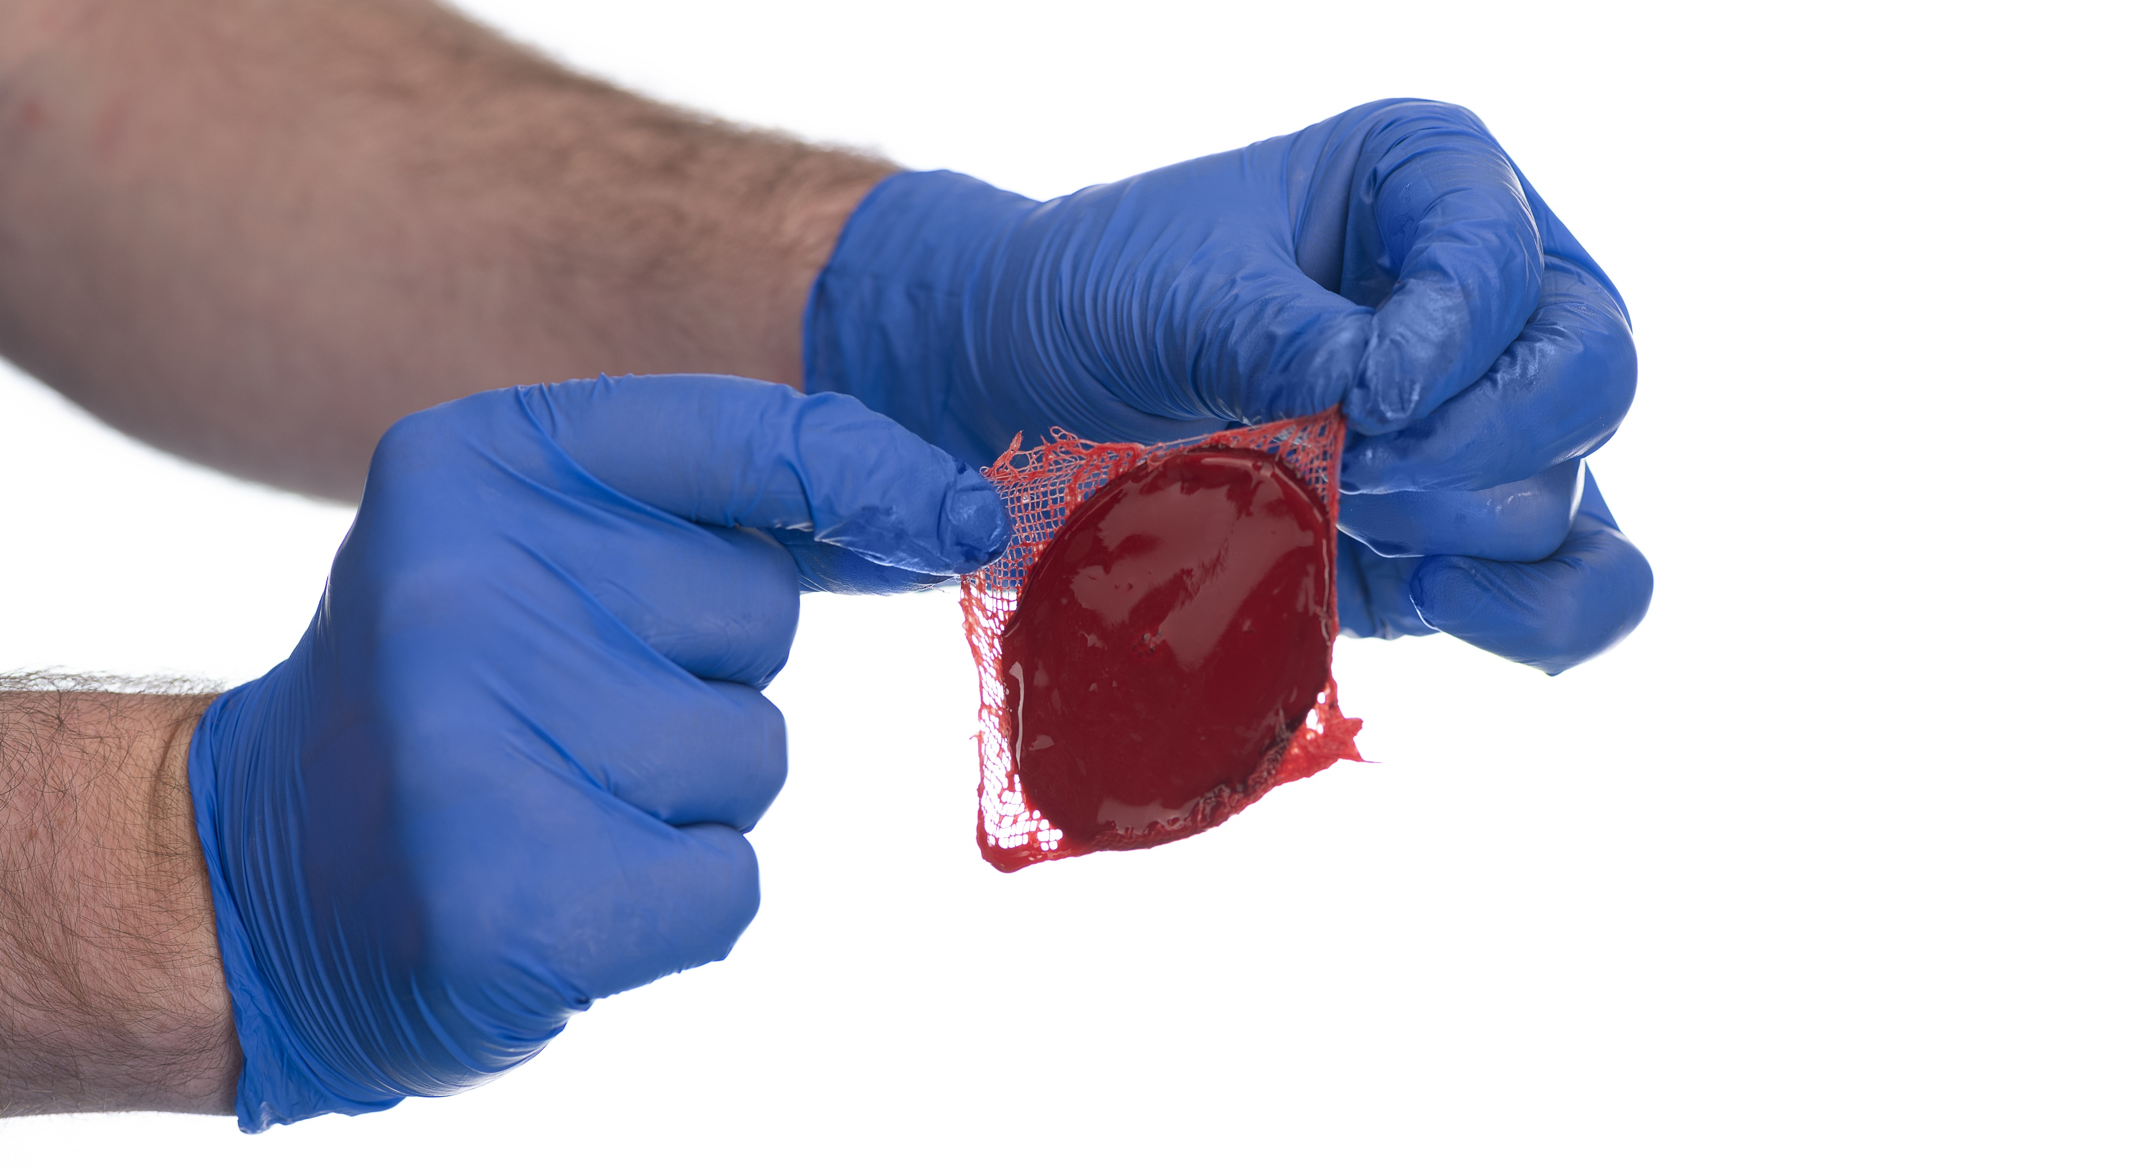
The WBC is ready for application to the patient’s wound.

Slide 23
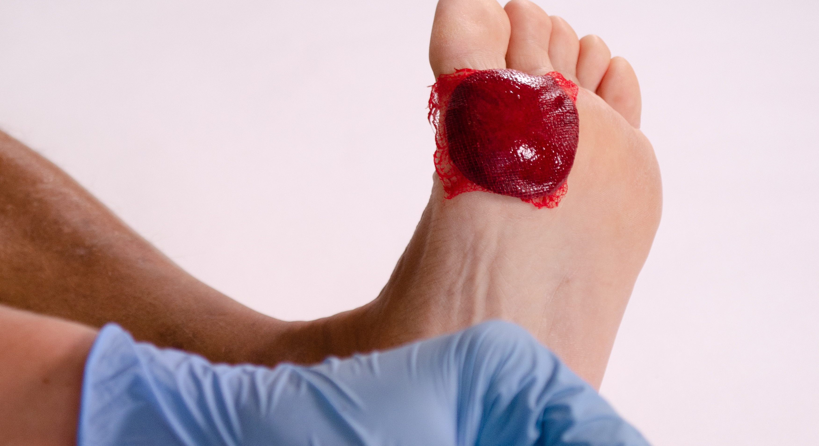
**TRIM THE CLOT TO THE SIZE OF THE WOUND**
** DO NOT OVERLAP THE CLOT MATERIAL ON PERIWOUND OR “GOOD” SKIN **
Apply the WBC to the patient’s wound with the gauze-side facing upward.

Slide 24
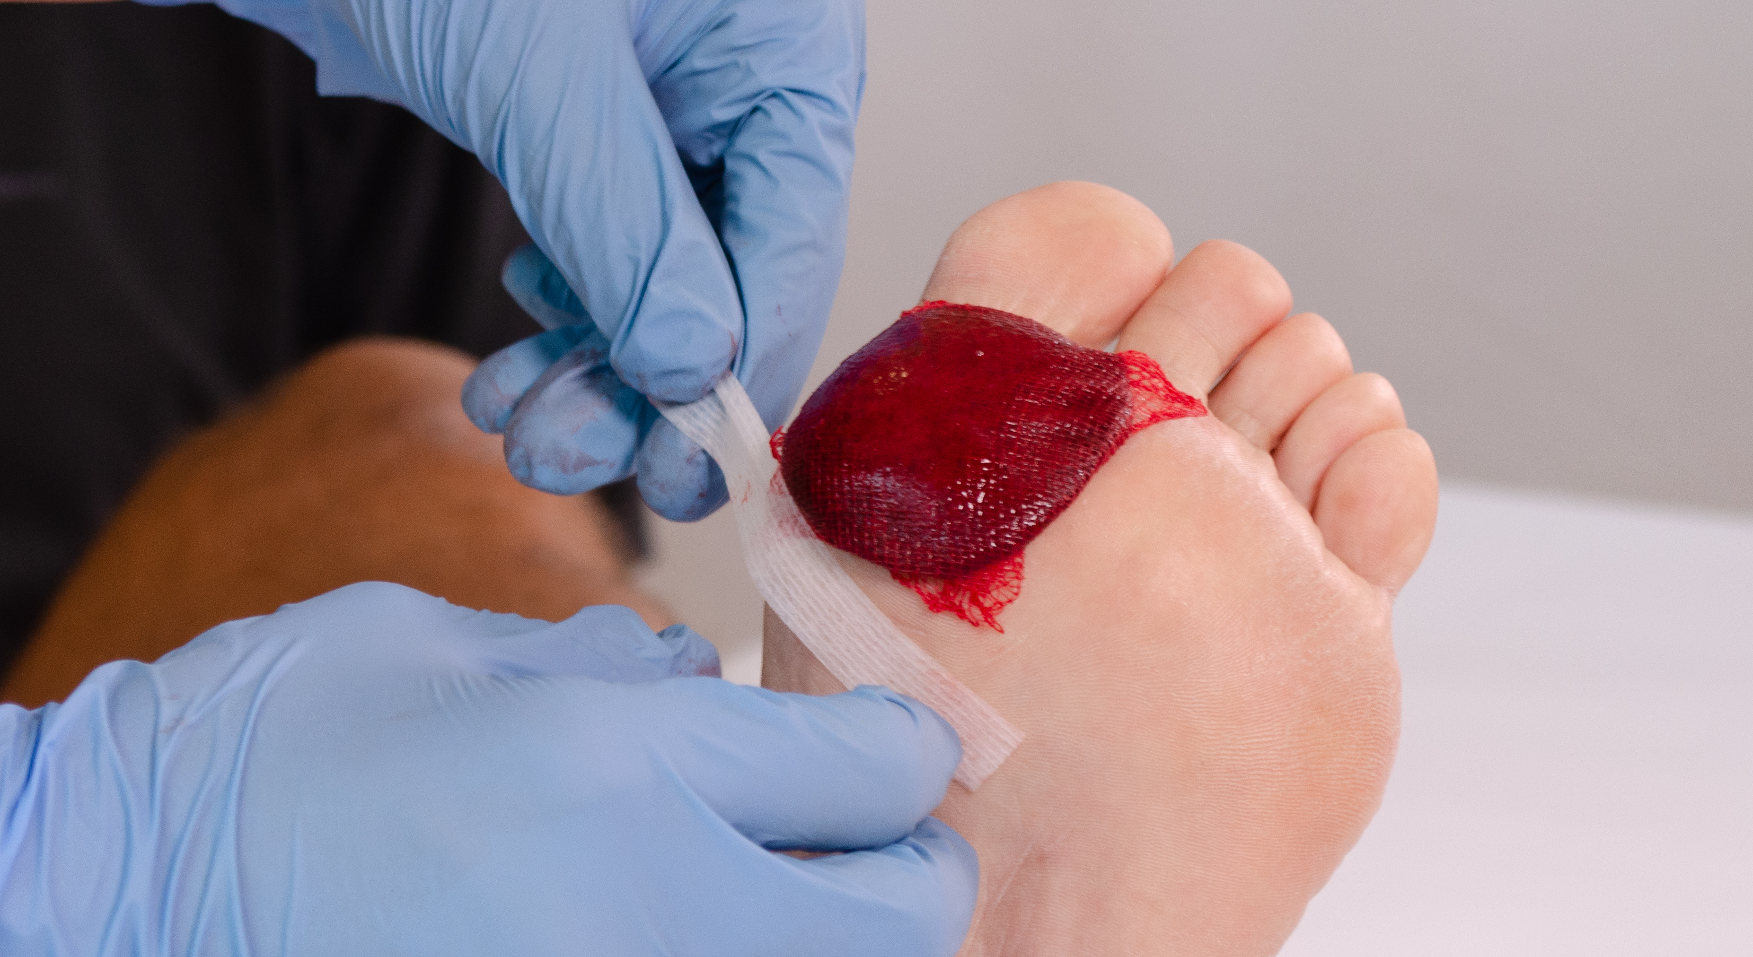
Anchor the WBC to the patient’s skin with Steri Strips.

Slide 25
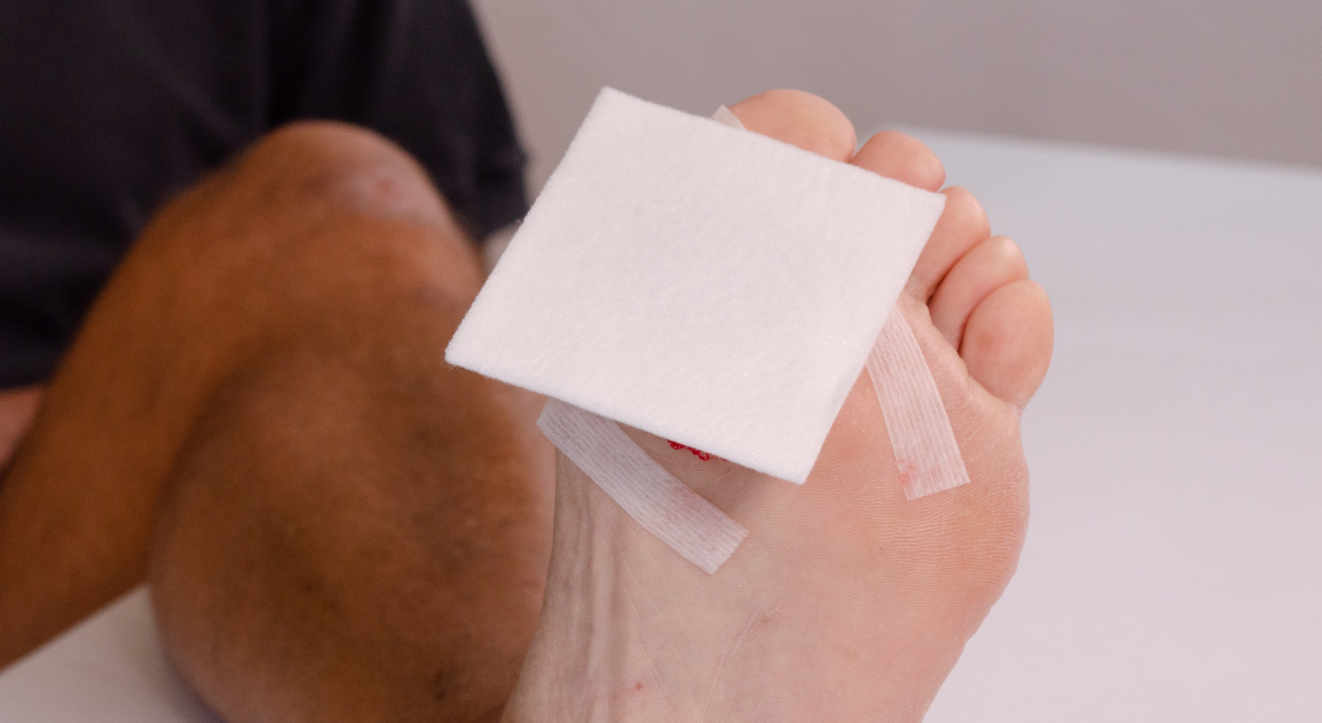
Place a non-adherent pad over the WBC and Steri Strips.

Slide 26
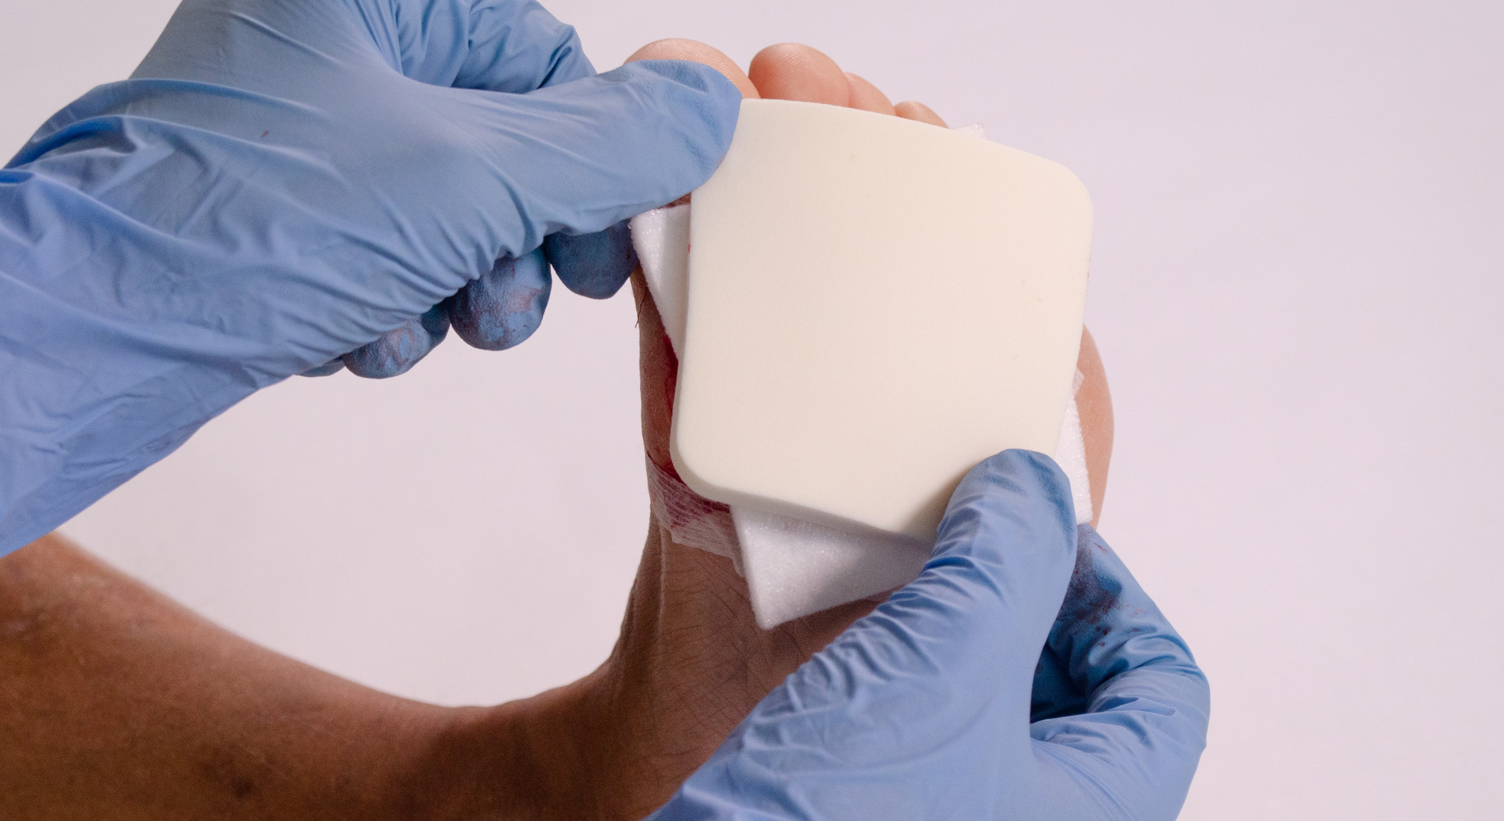
Apply the foam dressing on top – or provider’s choice of secondary dressing.

Slide 27
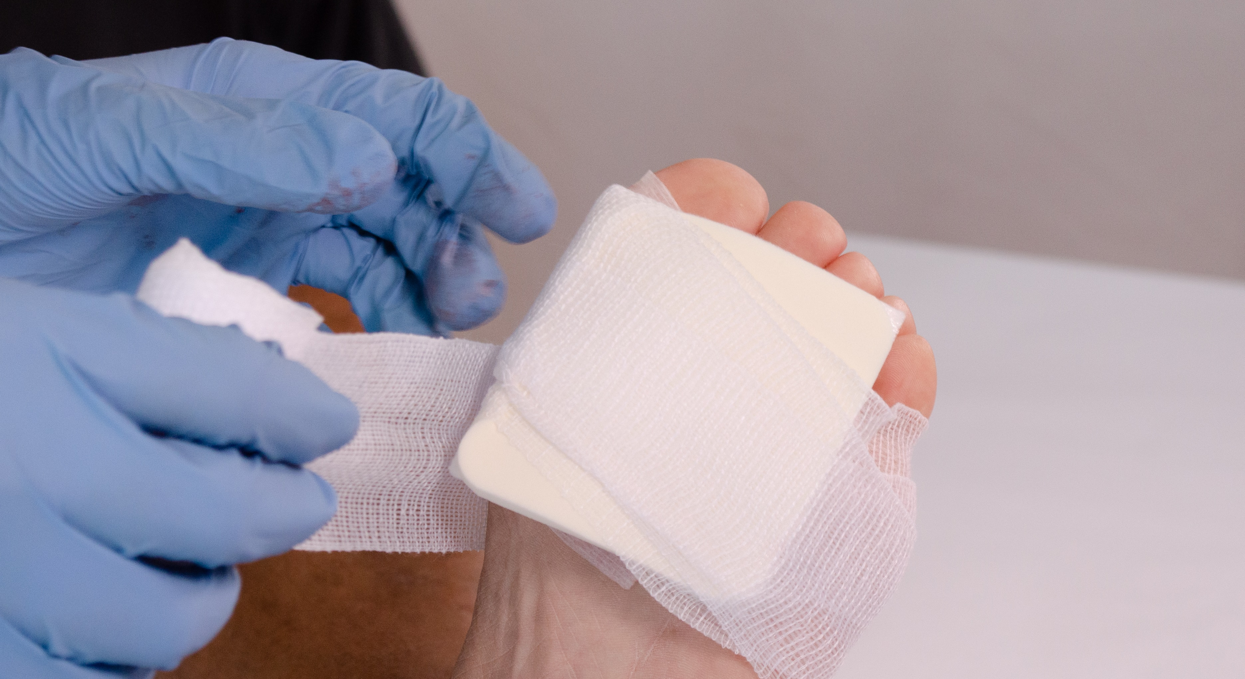
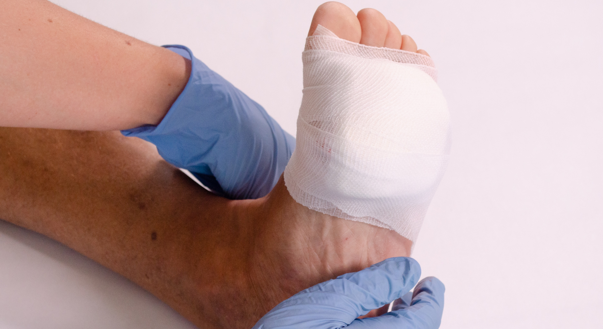
Secure the dressings with gauze – or provider’s choice of secondary dressing.
** IMPORTANT**
Secondary dressings MUST be monitored for exudate
If 75% or more of the dressing is saturated, secondaries must be changed.
Change dressings down to the steri-strips – do not disturb ActiGraft clot itself.

